Slide 1
An NSS Audio-Visual
Library Presentation
Onyx Cave, AZ
Escabrosa Grotto of the NSS
S740 78 Slides 2/09/2021
Notes:
Prologue: Onyx Cave, Arizona, is located about a one hour drive southeast of Tucson near the small town of Sonoita. It is formed in a small block of Permian-aged Concha limestone. The cave is widely known for its spectacular shields and helictites. The front part of the cave was the scene of a short-lived onyx mining operation in the early years of this century. It contains approximately two miles of passage and has been heavily visited since the 1920'. Much vandalism has occurred, but the entrance has been controlled successfully by cavers since 1973, and considerable restoration has been accomplished. Enjoy your armchair tour of one of Arizona's most outstanding natural features.

Slide 2
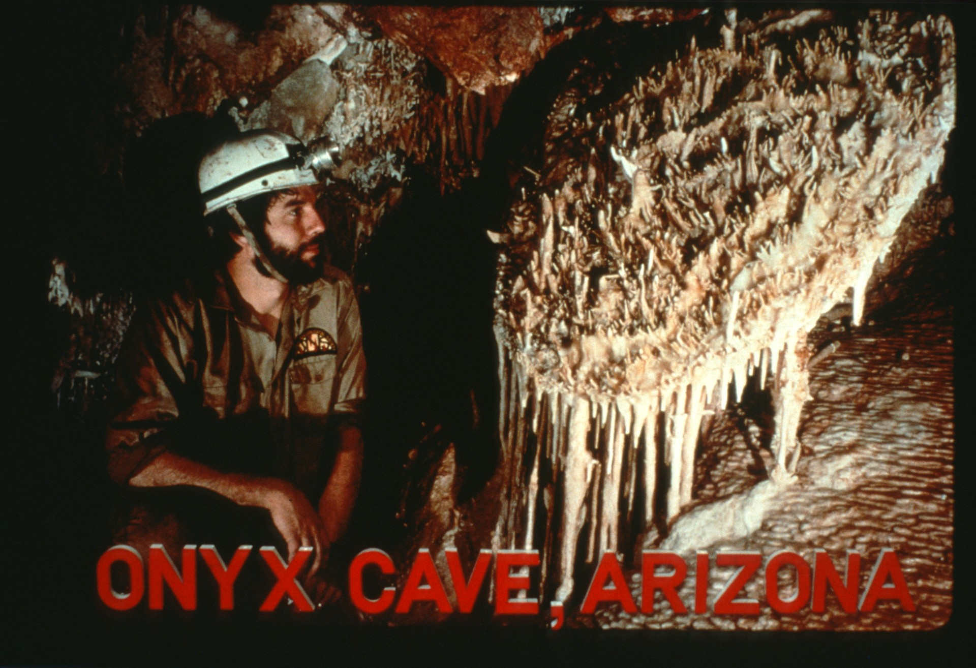
Notes:
“ONYX CAVE, ARIZONA" Former Escabrosa Grotto member Ted Pate is admiring a fine example of a shield or palette formation. Onyx Cave shields are often profusely adorned with helictites.

Slide 3
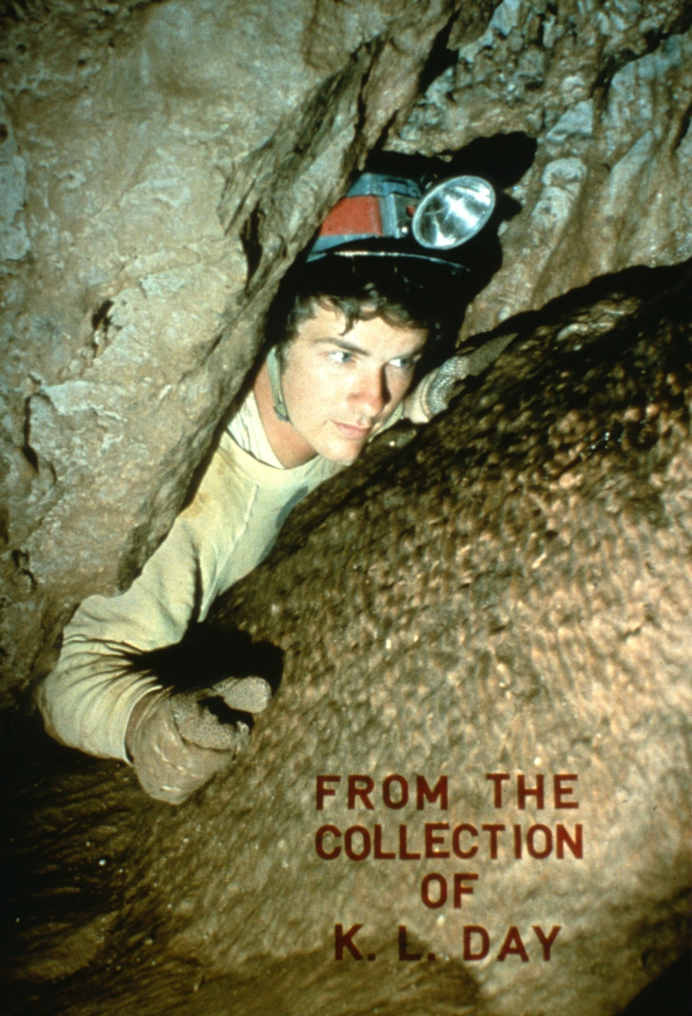
Notes:
"FROM THE COLLECTION OF K. L. DAY" Rick Day emerges from the Knick-Knack Room. Tight squeezes like this guard most of the cave's better rooms.

Slide 4
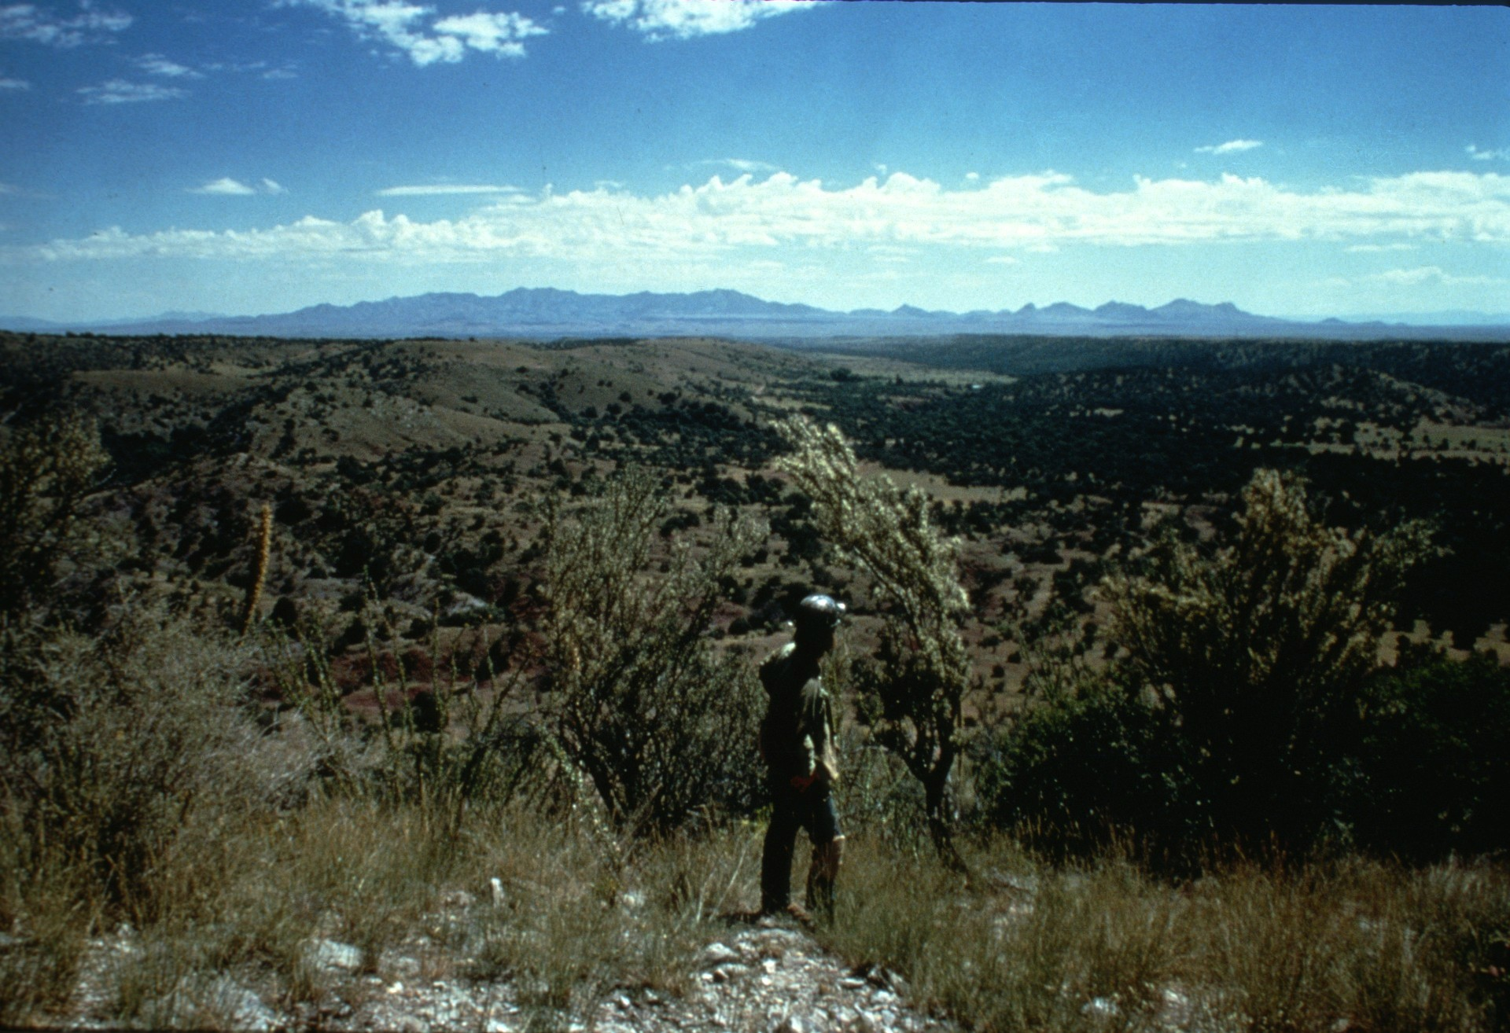
Notes:
Onyx Cave is located about one mile above sea level in the rolling grasslands of Southeastern Arizona. This view, taken from near the entrance, shows the Whetstone and Mustang mountains in the distance. The elevation and relatively higher rainfall here explain the lack of the famous Arizona cactus, the Saguaro.

Slide 5
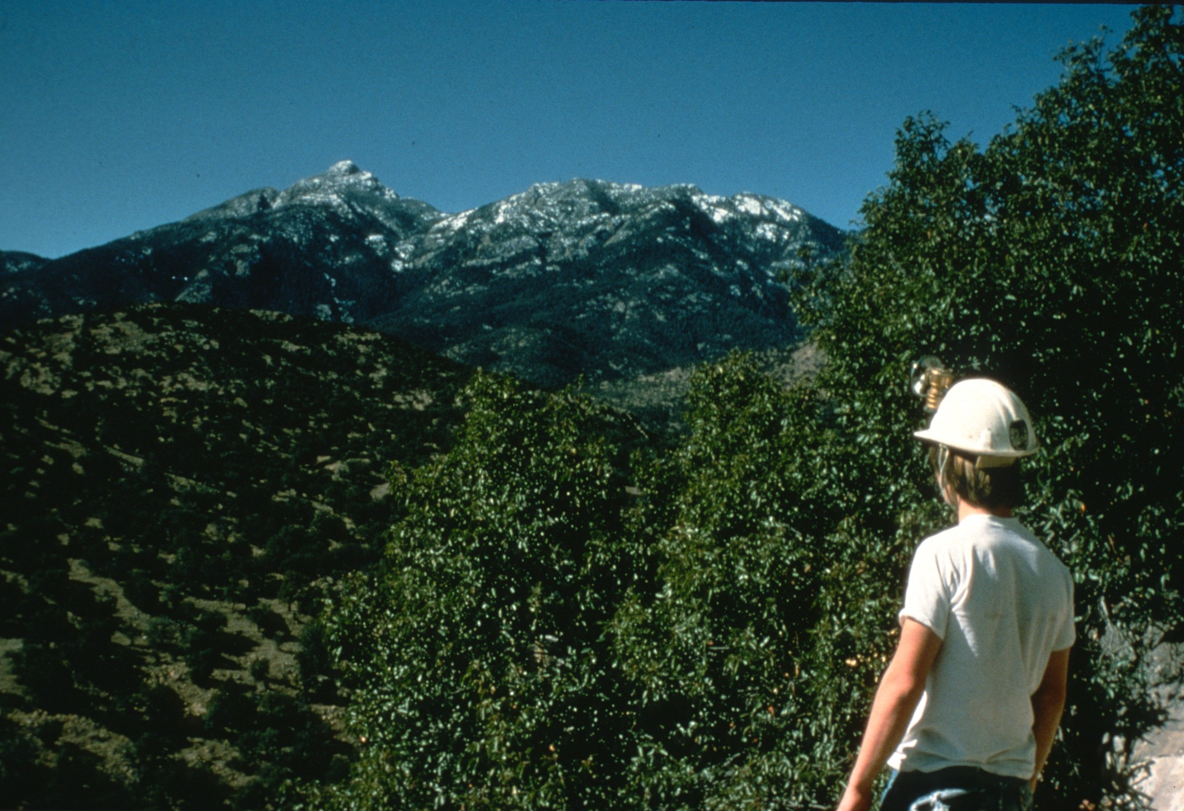
Notes:
Caver Doug Powell is standing just outside the entrance of the cave and looking at snow-capped Mt. Wrightson, over 9,300 feet tall. Snow generally doesn't last long here. Onyx is actually formed in one of the foothills of this peak.

Slide 6
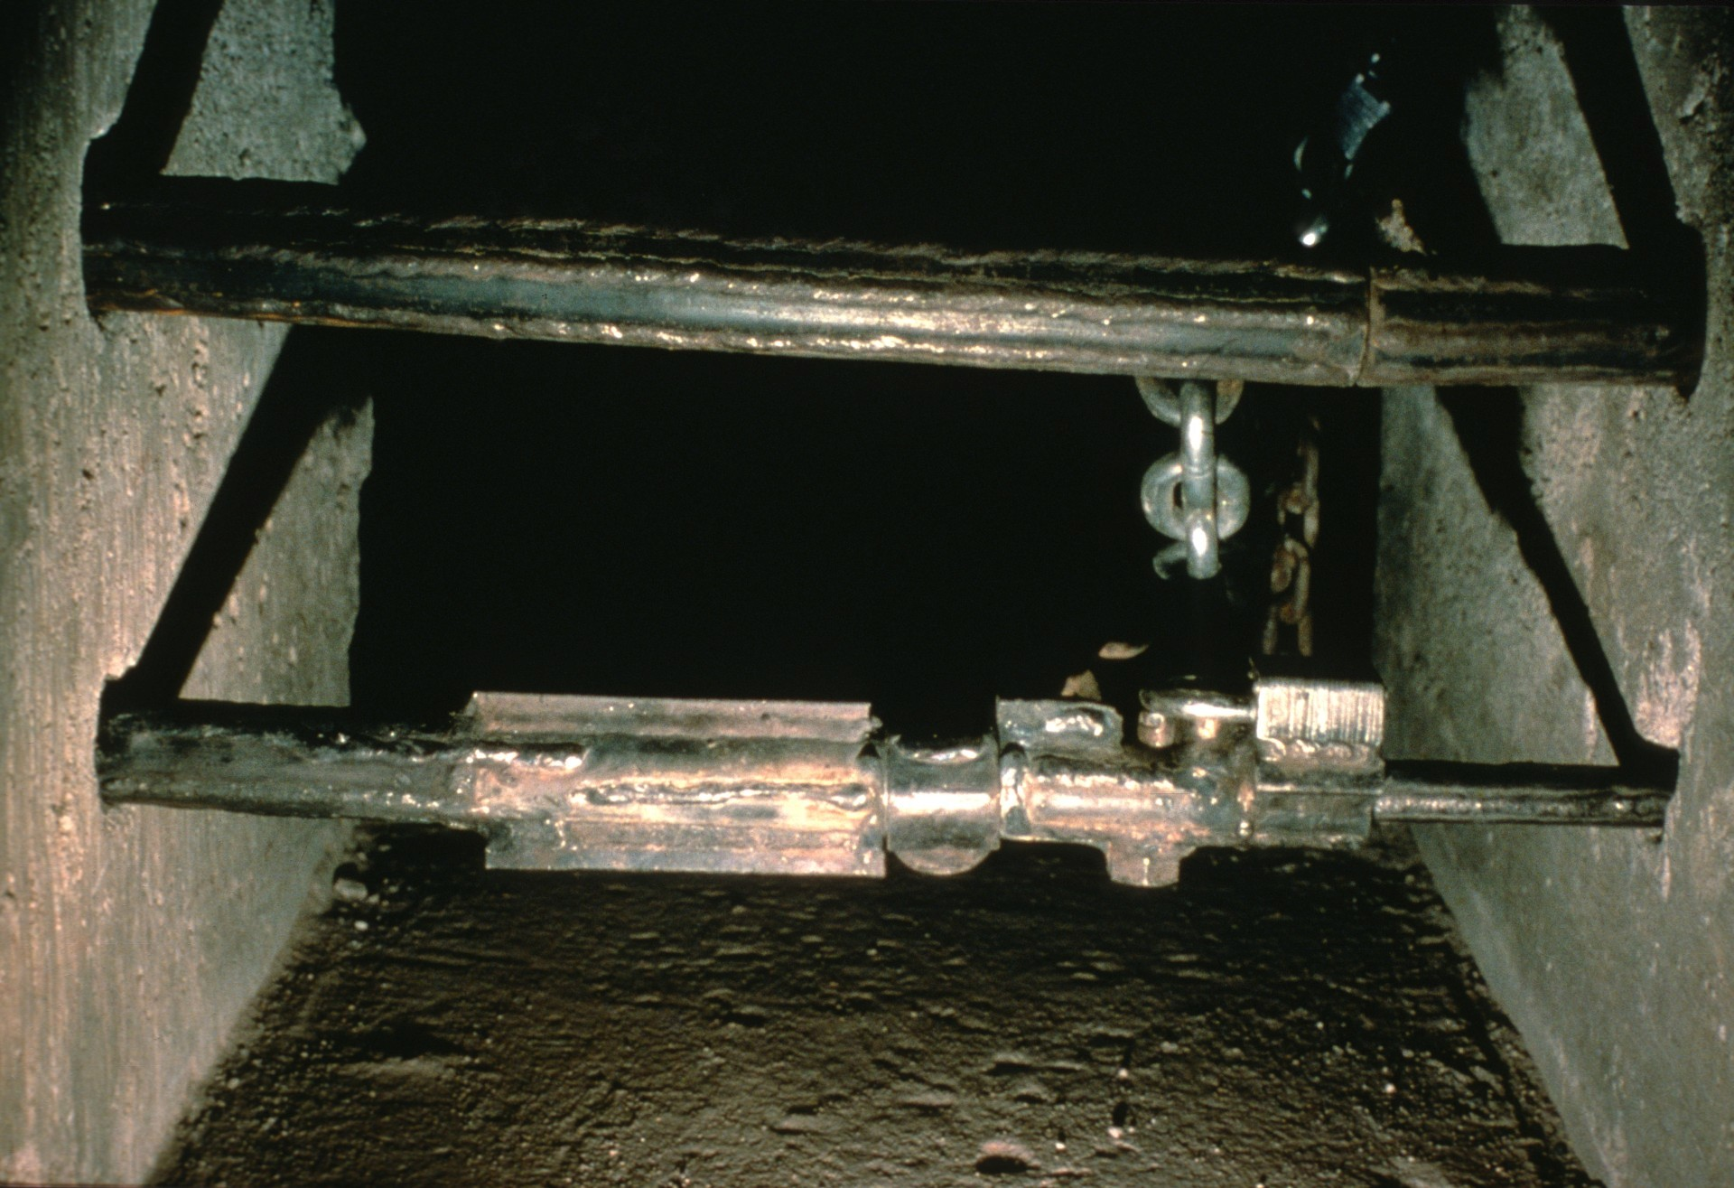
Notes:
Onyx Cave was completely unregulated for many years. Many of its choicest treasures were devastated by vandals. One inexperienced caver lost his life in a fall down a 180-foot pit. The cave was leased by Escabrosa Grotto of Tucson in 1973 for one dollar per year and immediately gated. Over two dozen gates were destroyed in the first two years. This slide shows the gate in the Fall of 1974.

Slide 7
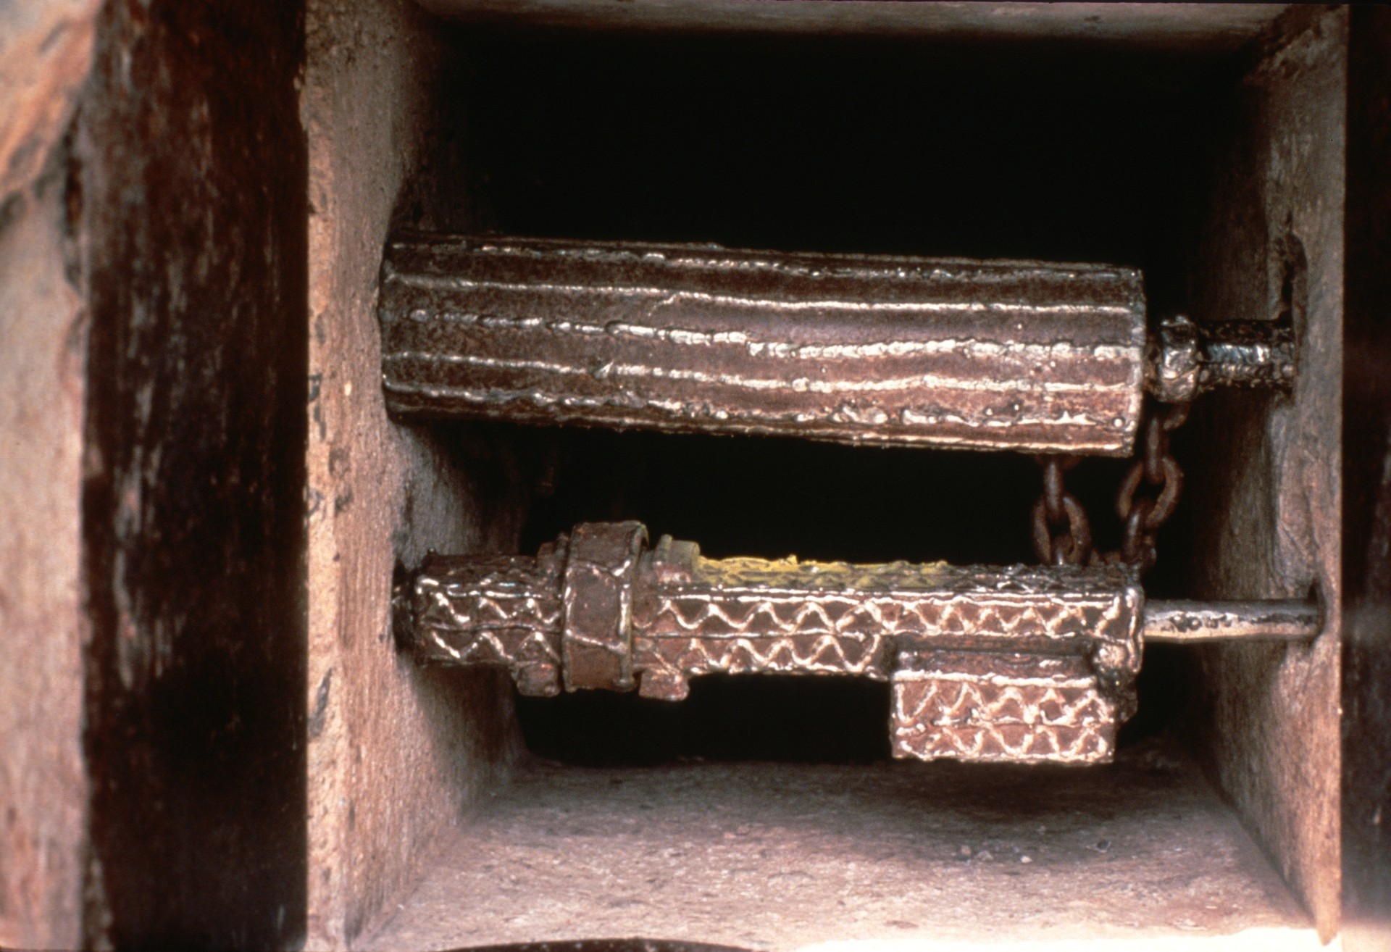
Notes:
By the middle 1980's the same basic gate design was still in use, but every significant part had been heavily reinforced. This gate has only been broken once in the past seven years.

Slide 8
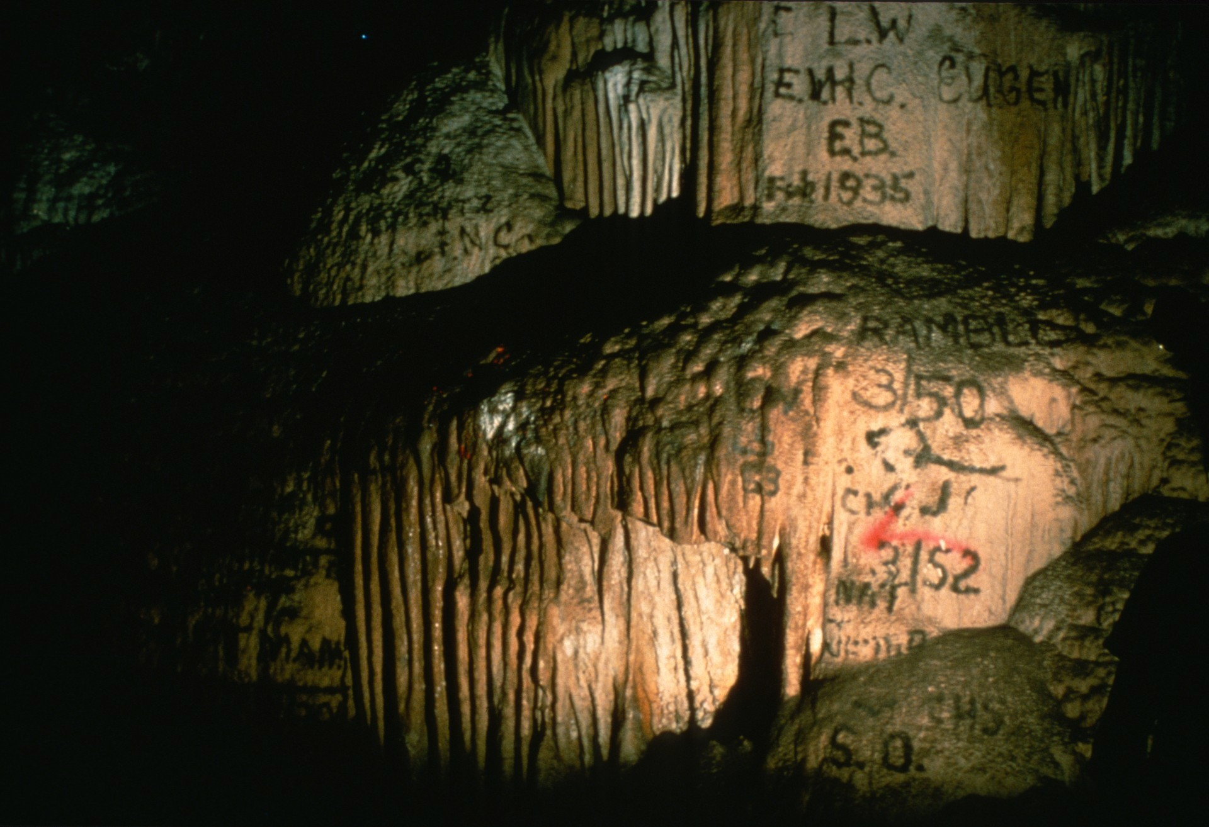
Notes:
The first few hundred feet of the cave are easy going, and were heavily spray-painted over the years. Numerous clean-ups have been held, and areas such as this are now clean again.

Slide 9
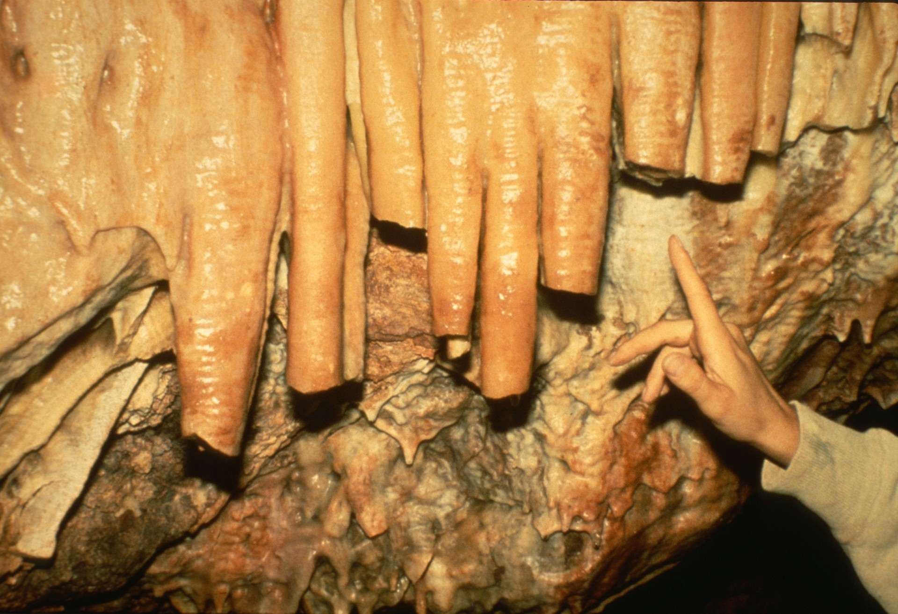
Notes:
Not so easy, or impossible to restore are areas like this. Scenes like this, and others much more heartbreaking, are all too common in Onyx Cave. It will be the main focus of this slide program to emphasize the great wealth of natural beauty that still remains.

Slide 10
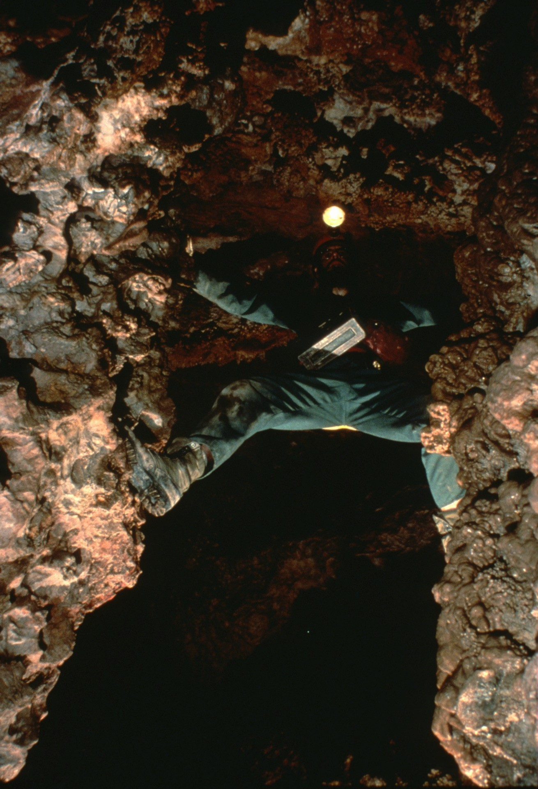
Notes:
Richard LaForge is shown chimneying part of "The Gorge." This 18-foot pit, a few hundred feet into the cave, has discouraged more than a few would-be explorers.

Slide 11
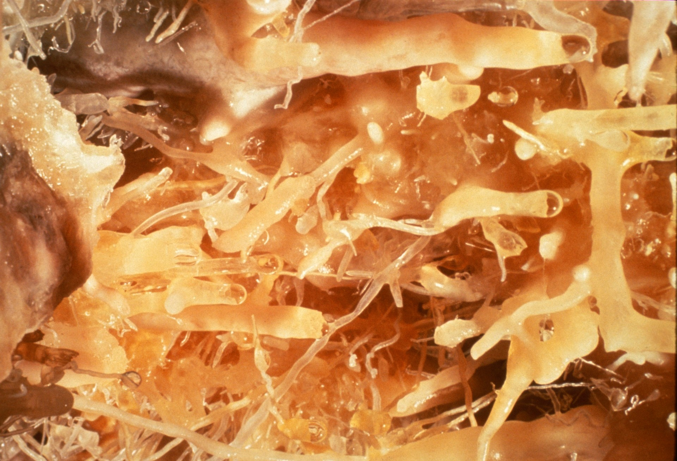
Notes:
A lead from the bottom of The Gorge goes to a small room which contains these gorgeous helictites and soda straws.

Slide 12
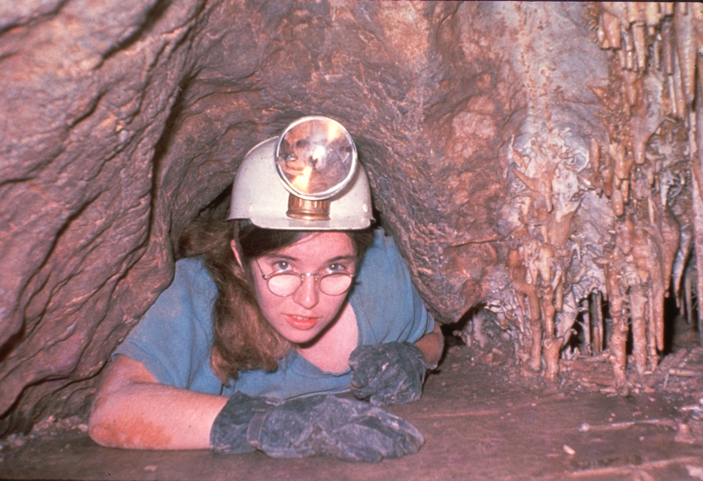
Notes:
Not far beyond The Gorge is the tight squeeze into The Knick-Knack Room. Caver Vicki Dirst completely fills the opening.

Slide 13
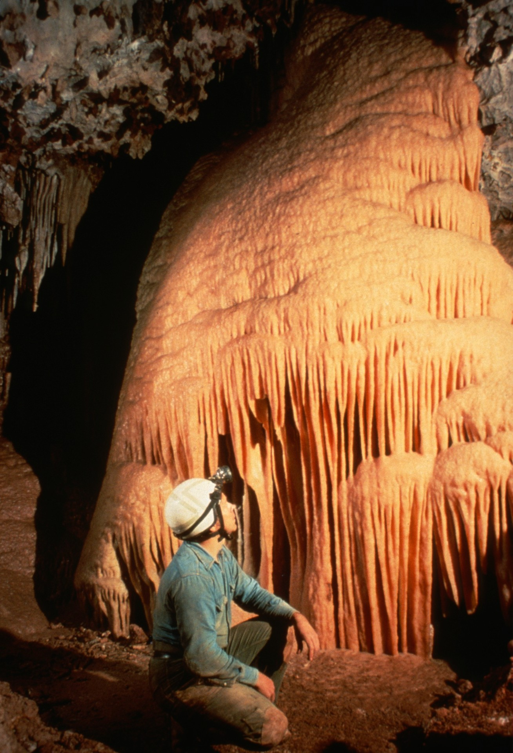
Notes:
A landmark of the Knick-Knack Room is the "Orange Sherbet Flow." Long-time Escabrosa Grotto member Marion Vittetoe is shown here in 1975.

Slide 14
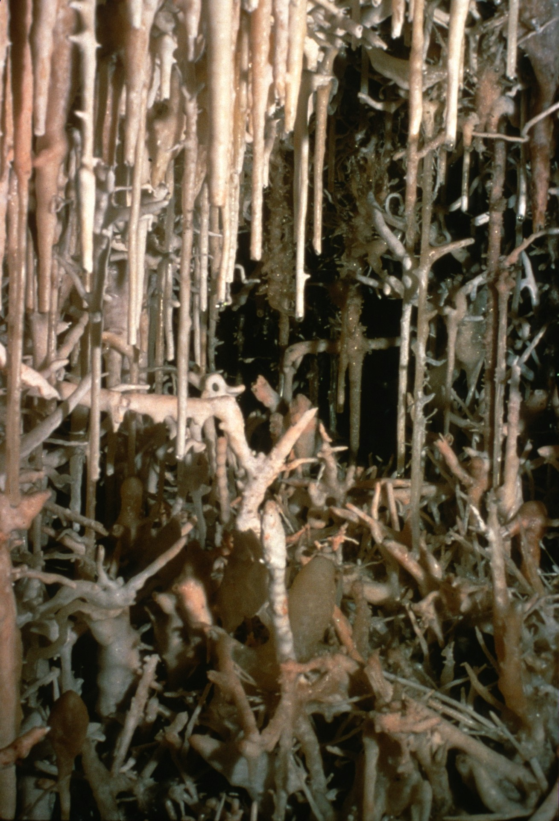
Notes:
This pocket of luxuriant formation growth typifies the Knick-Knack Room. .

Slide 15
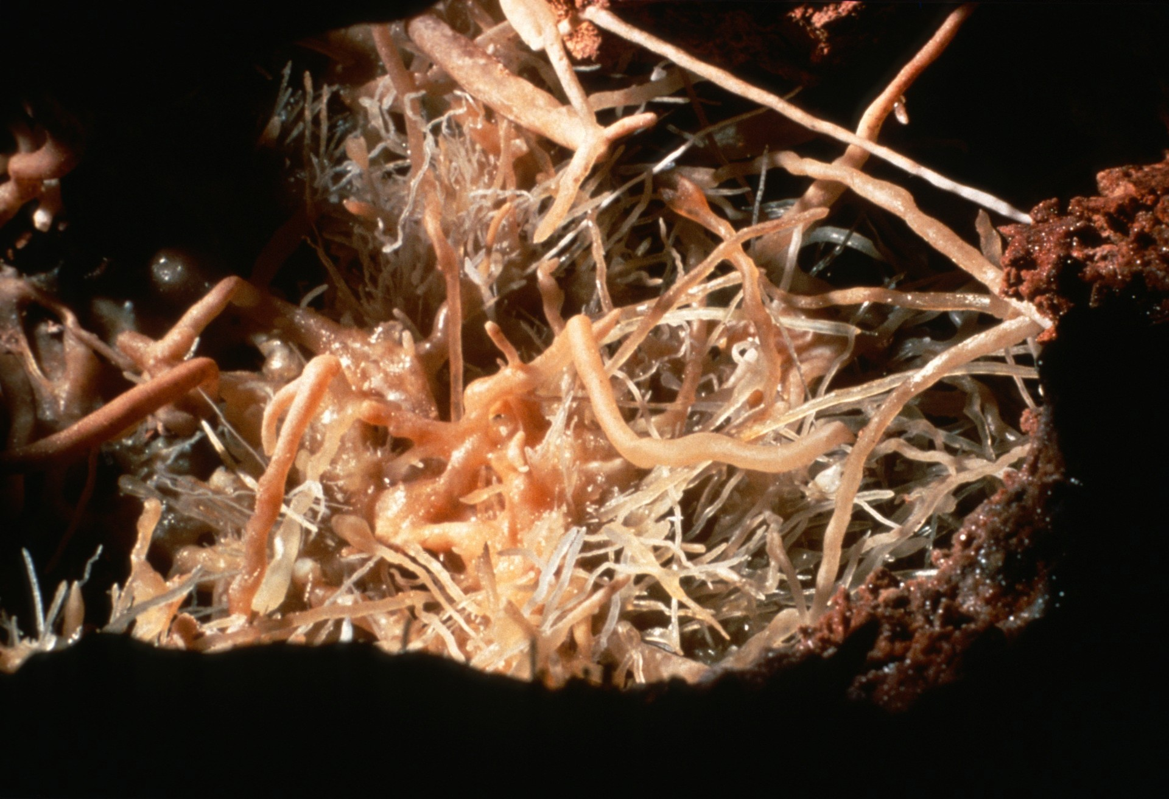
Notes:
A peep-hole into the bedrock reveals another delicate cluster of helictites.

Slide 16
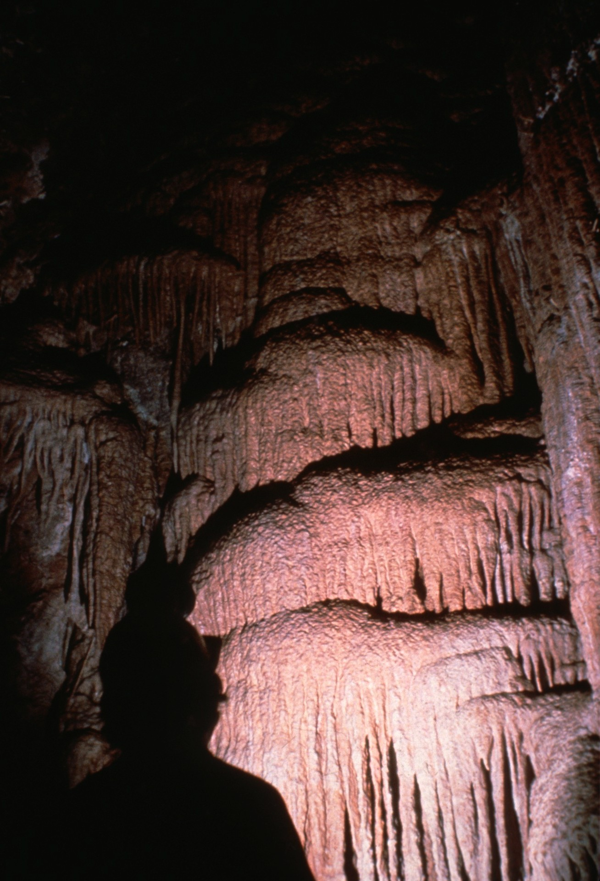
Notes:
While this room is best known for its delicacies, along one wall a large flowstone cascade tumbles from the ceiling.

Slide 17
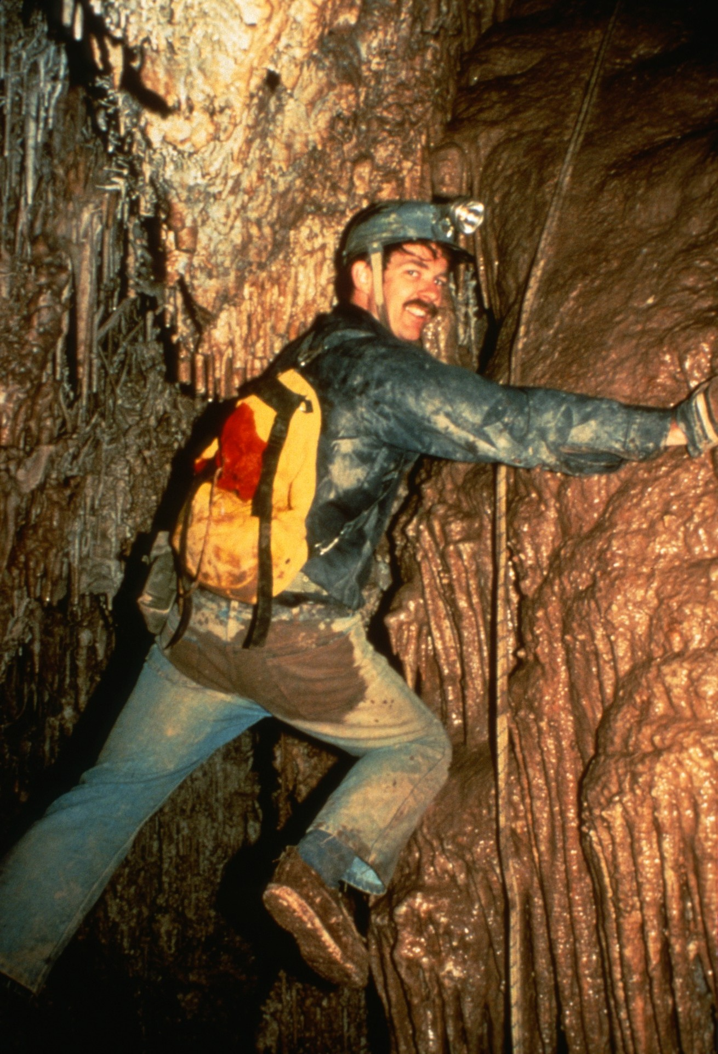
Notes:
Another nearby room is known as "The Basement." It 1s reached by negotiating a slope which becomes progressively steeper as the bottom approaches. This picture, by Paul Stevens, shows Rick Day not far from the bottom.

Slide 18
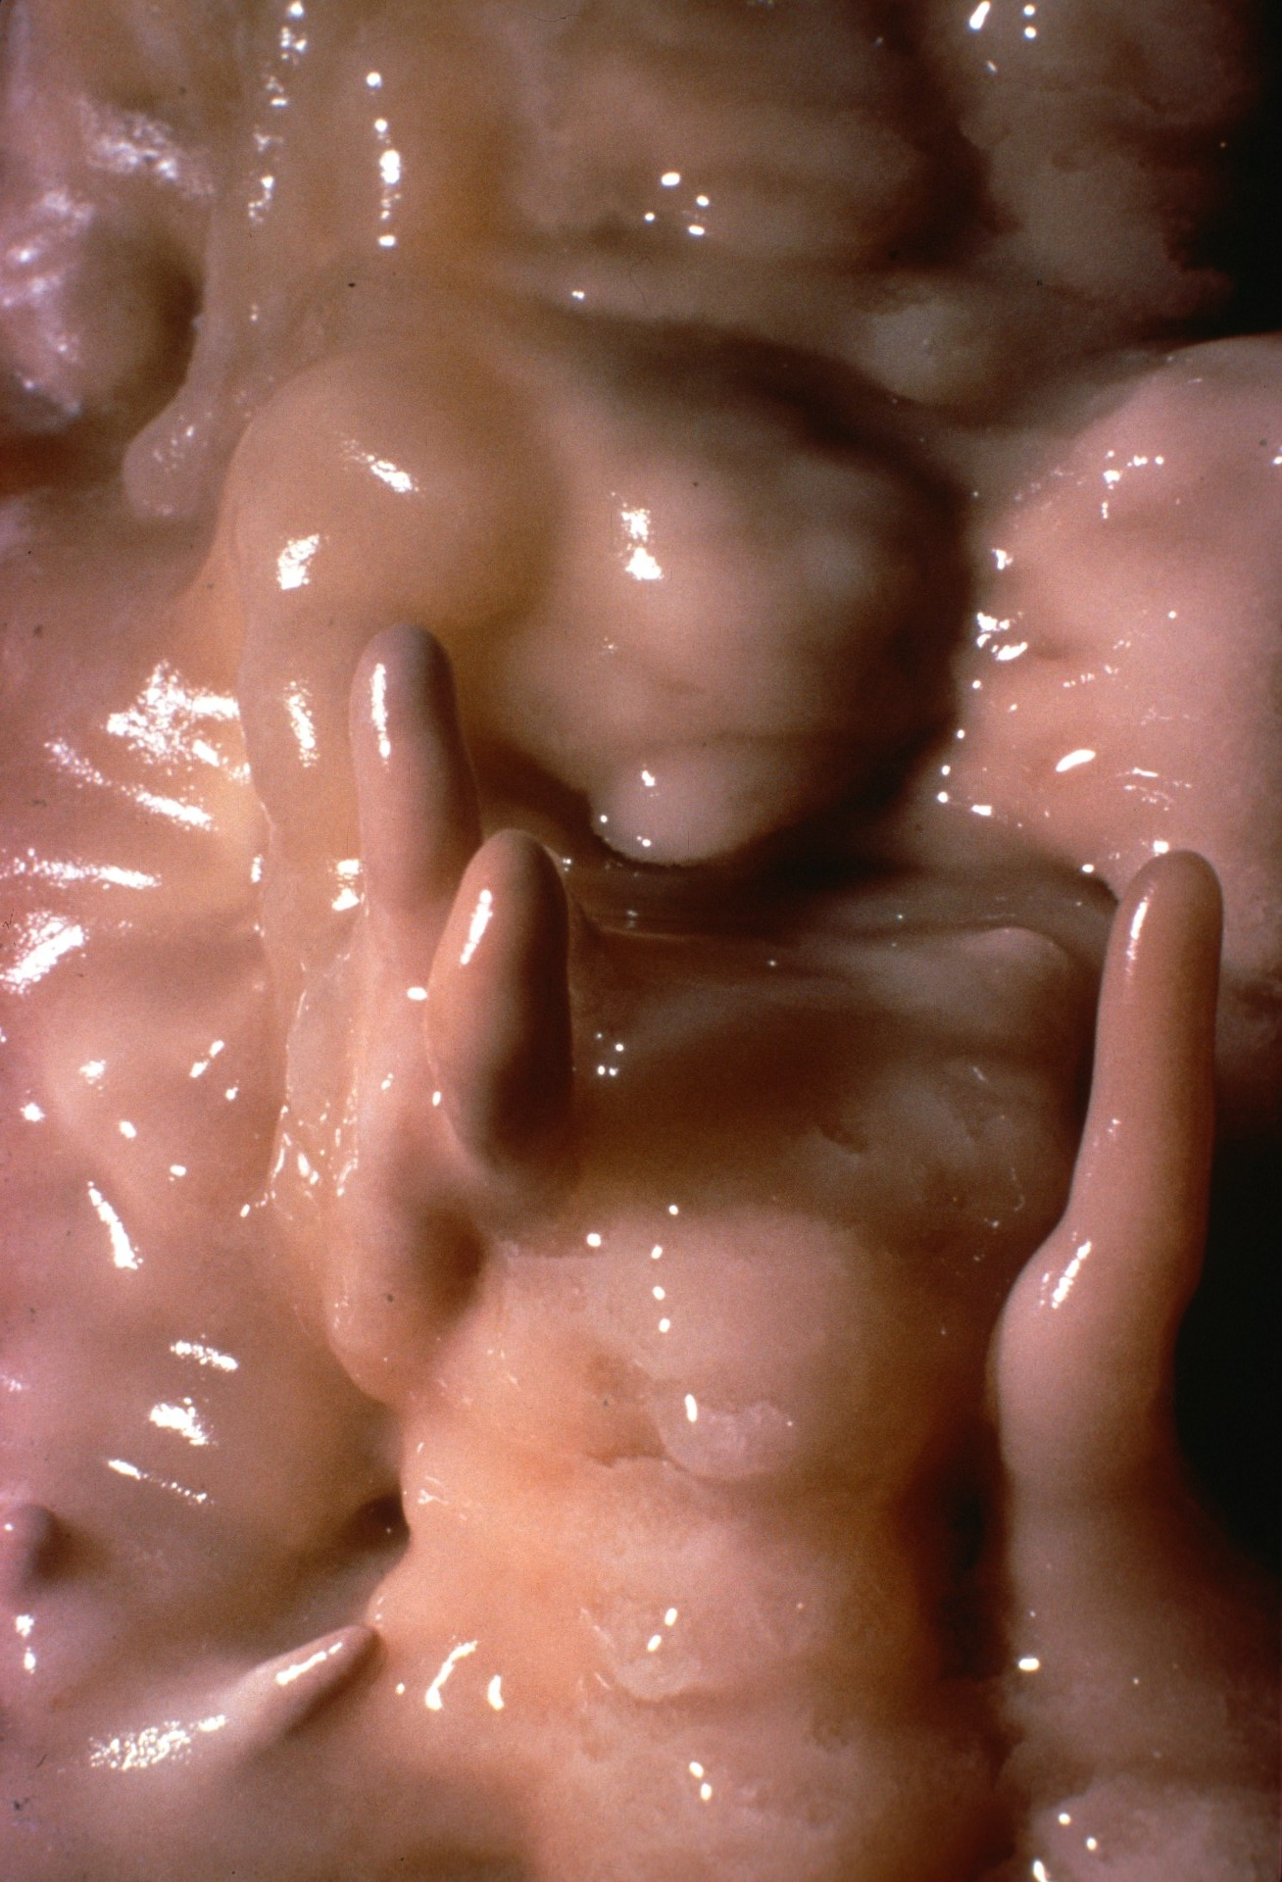
Notes:
This scene in The Basement typifies the onyx which gives the cave its name.

Slide 19
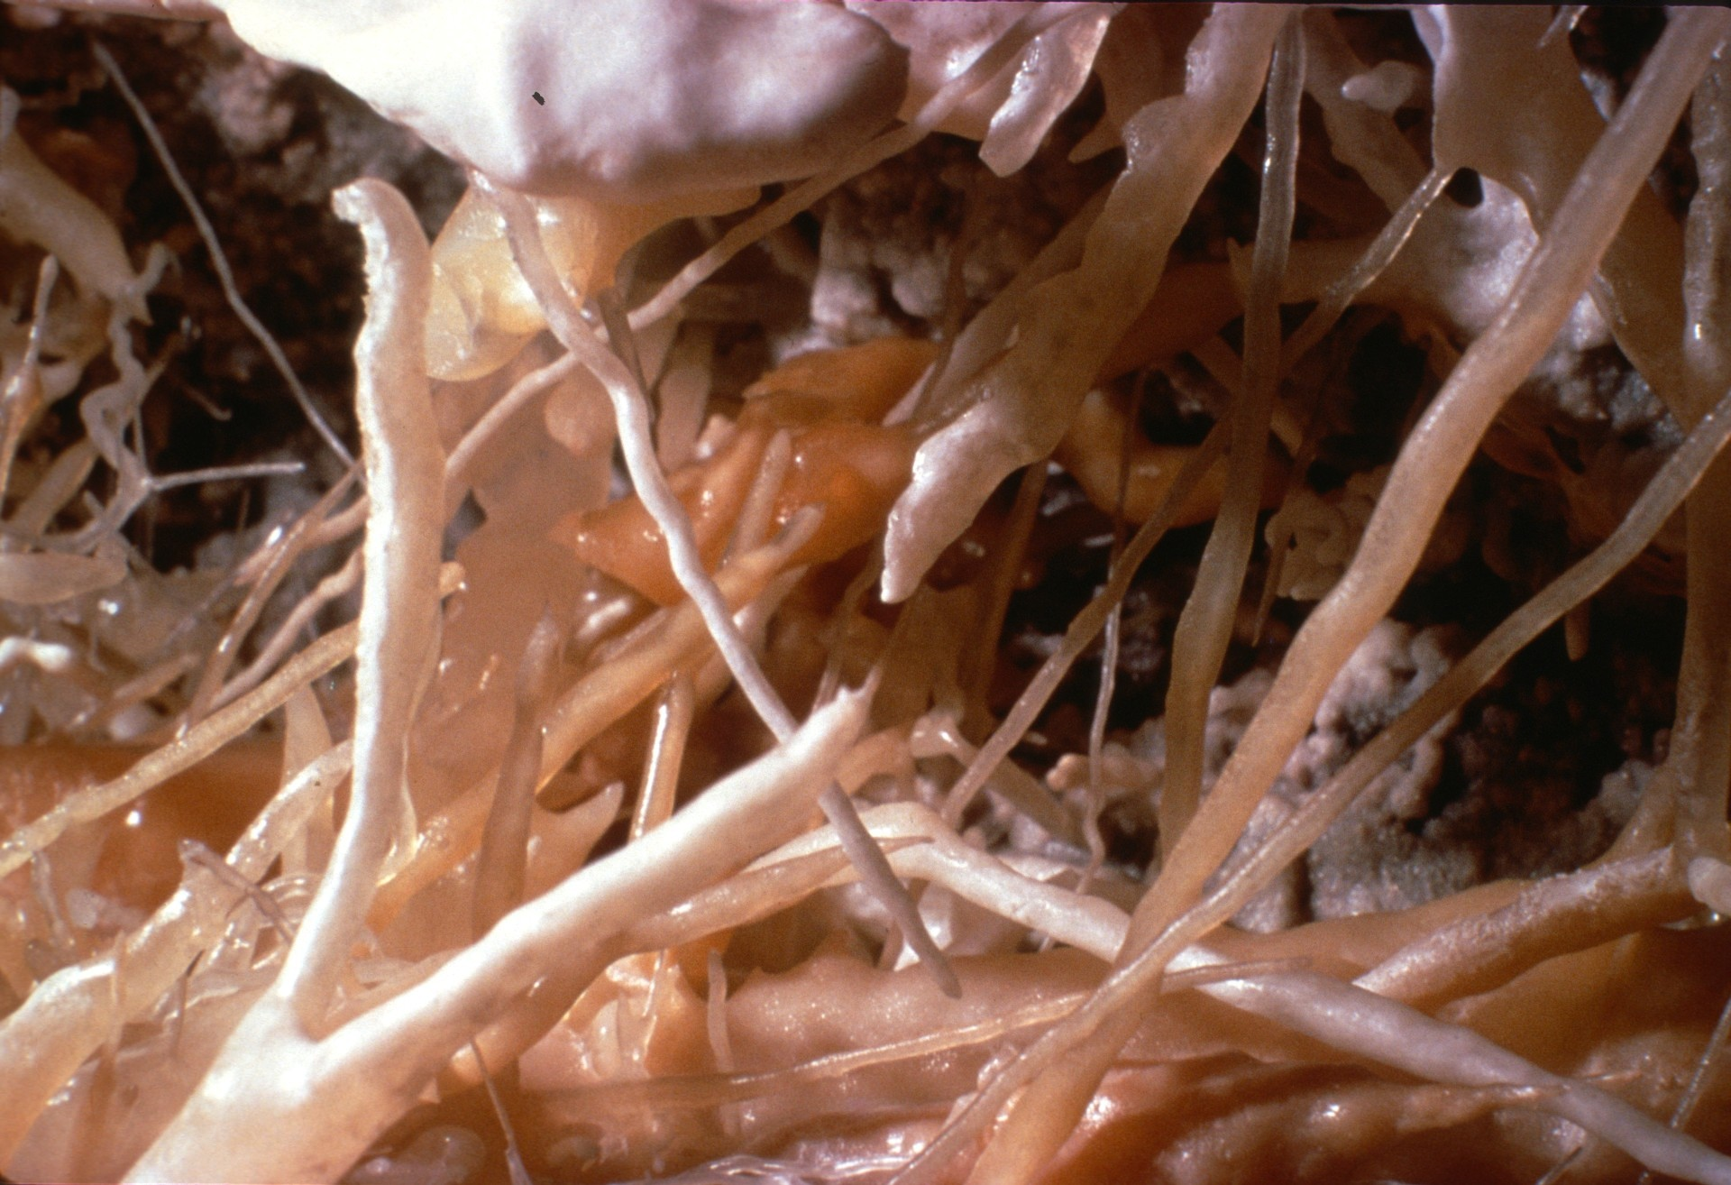
Notes:
Fine helictites abound in The Basement.

Slide 20
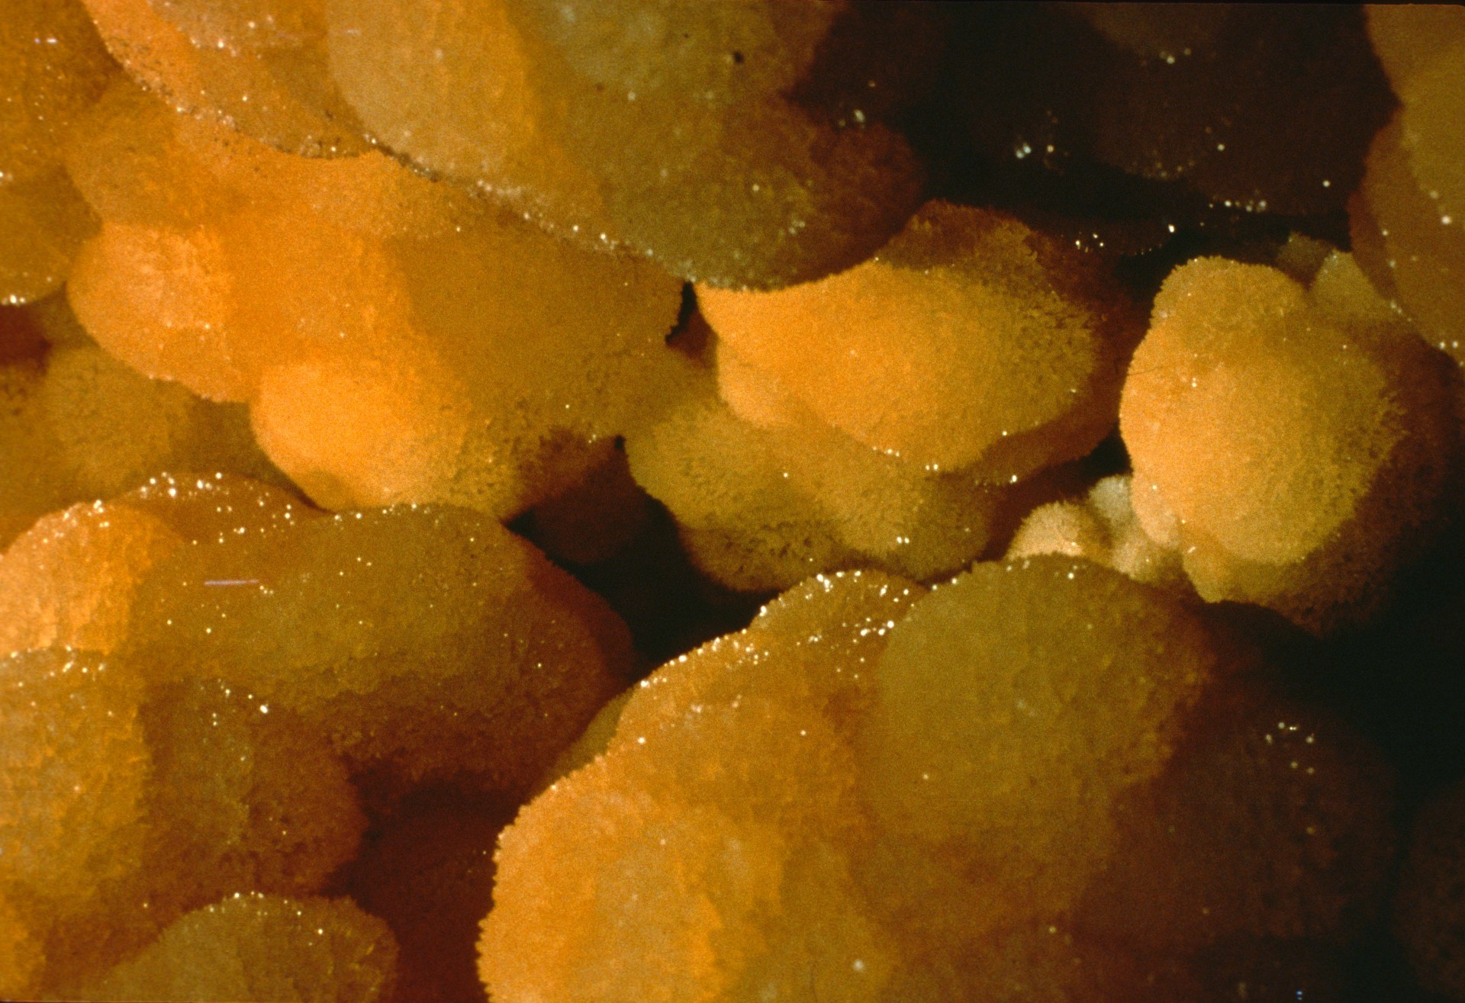
Notes:
A pool roughly ten by fifteen feet is completely lined with fine textured calcite crystals. Unfortunately, this area was very heavily vandalized by rockhounds in the 1960s.

Slide 21
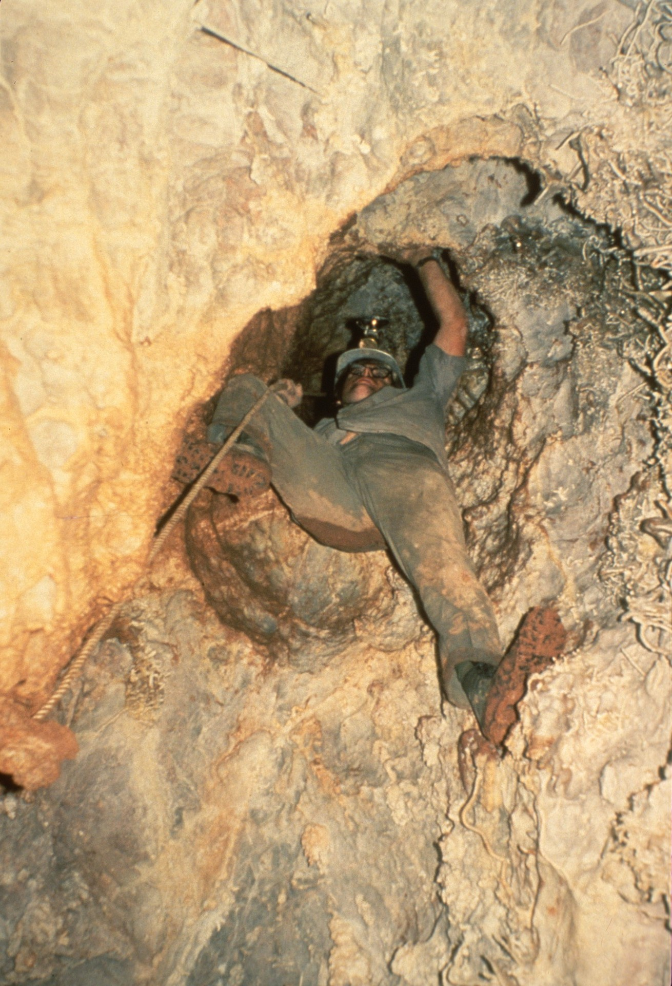
Notes:
Another room nearby the Basement is guarded by an extremely tight hole which bells out into a chimney. Former Tucson caver Arlin Pound is shown.

Slide 22
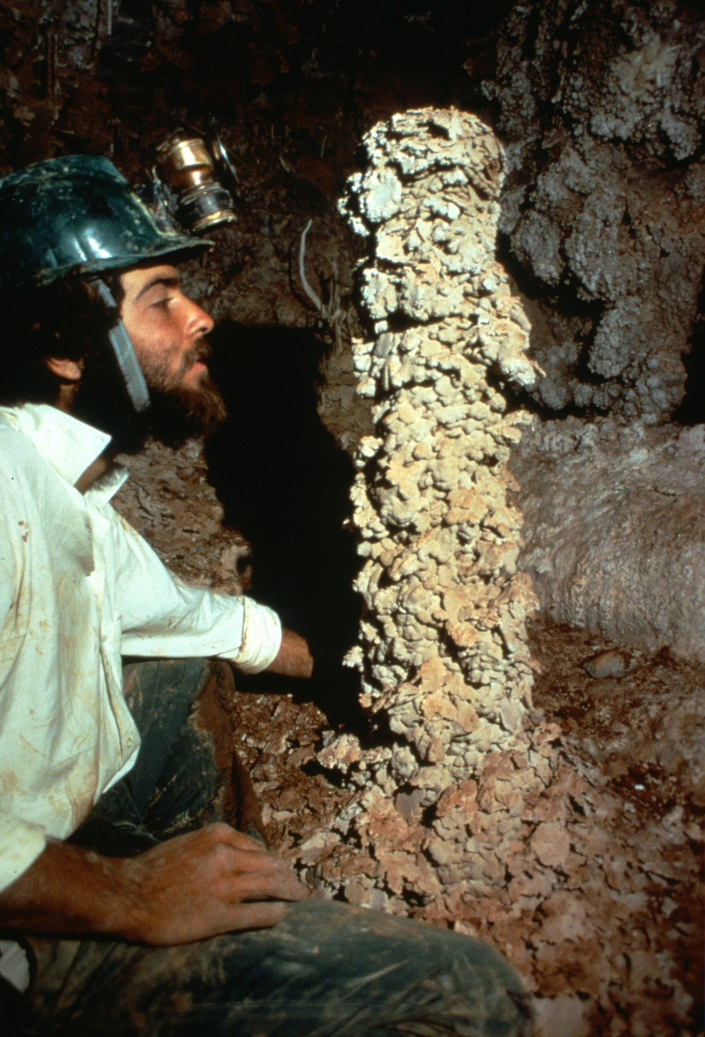
Notes:
Eric Means examines one of the unusual features of this room. This stalagmite is completely overladen with coarse-textured calcite flakes, apparently a relic of a now-vanished pool. Many cavers, when shown this slide, think they are being fooled by a phony formation built by a caver while waiting for someone to return from checking a lead.

Slide 23
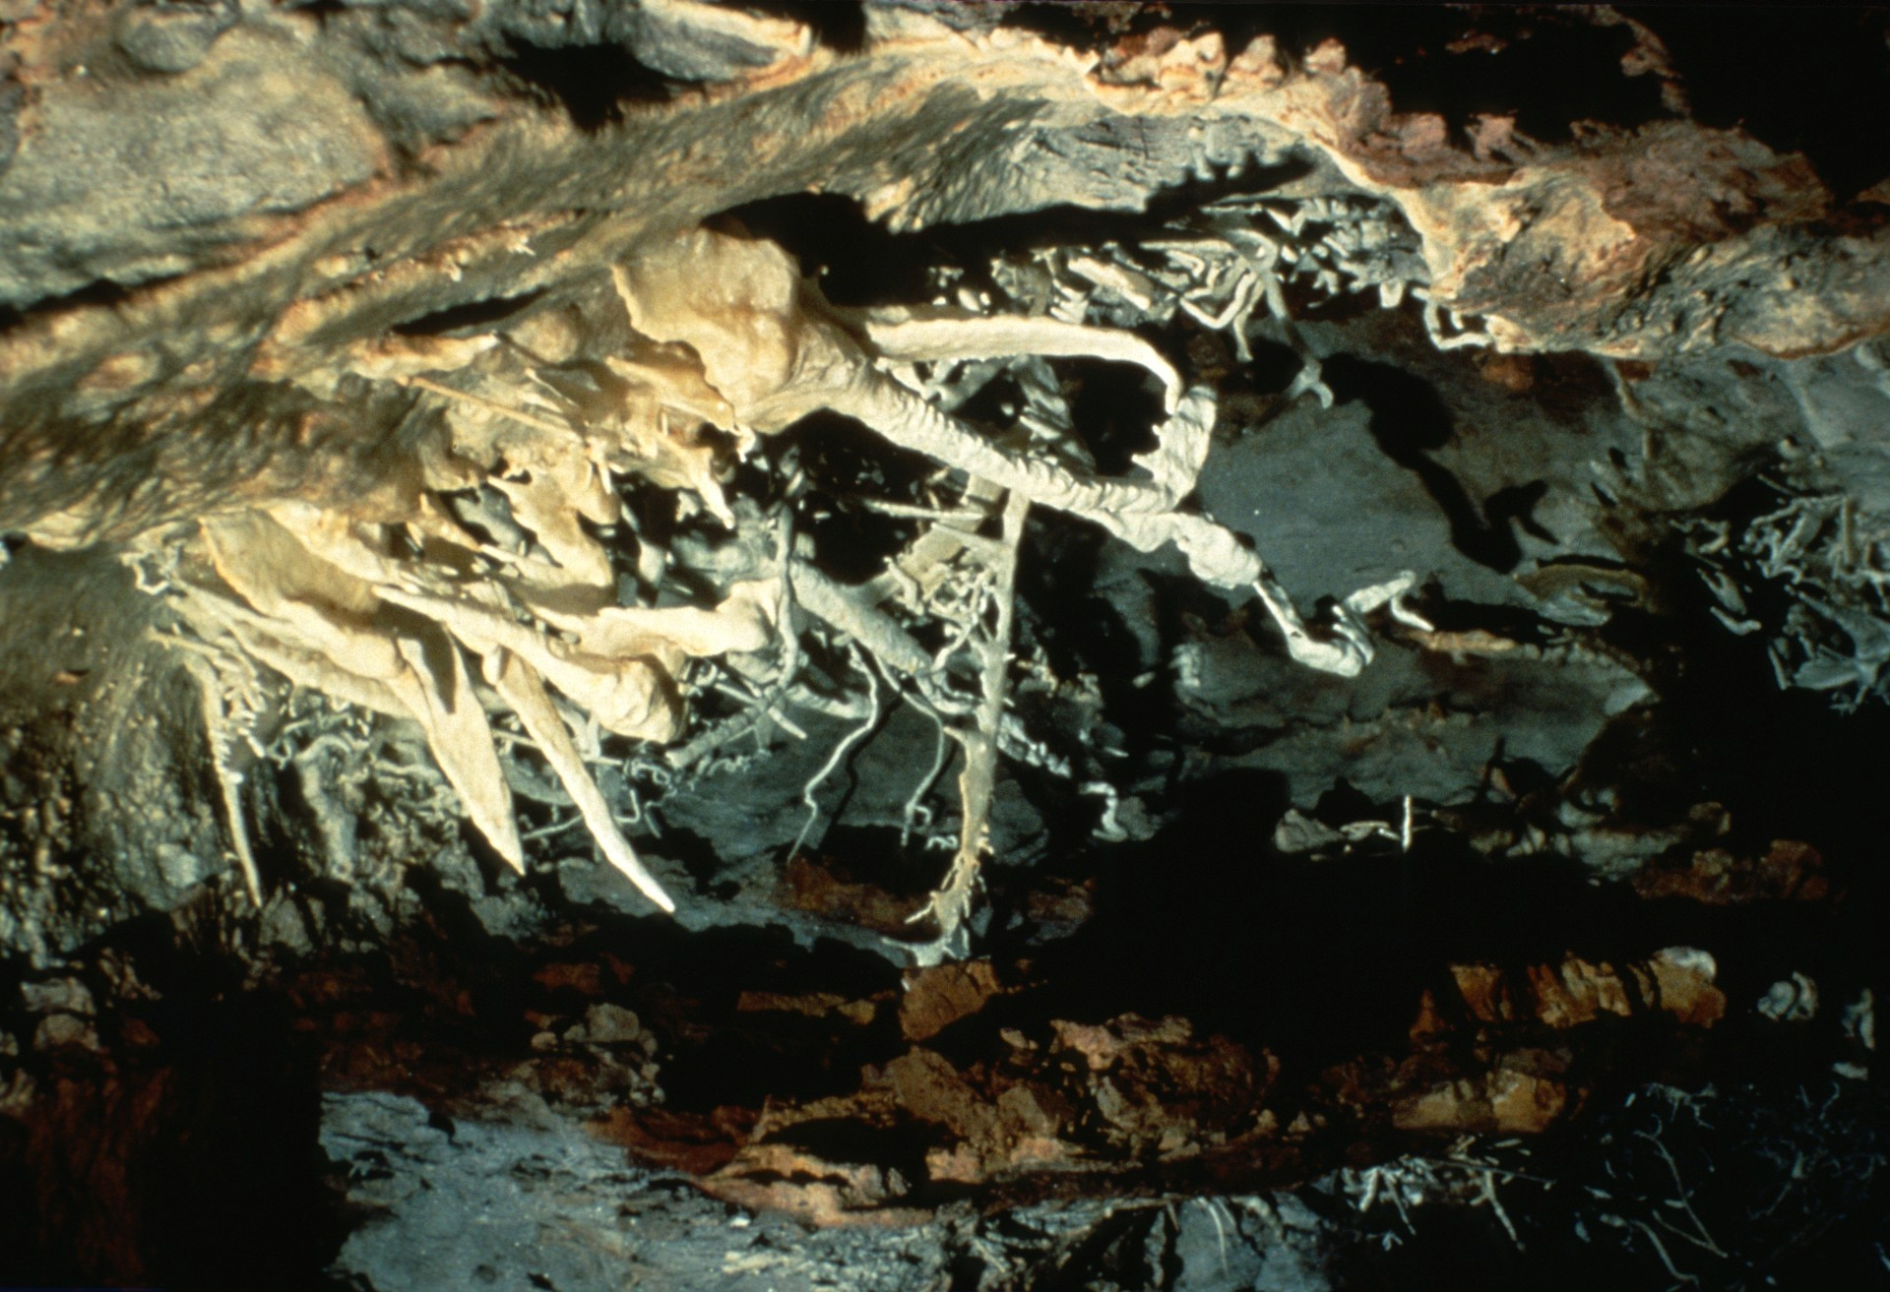
Notes:
Nearby are some helictites very root-like in appearance.

Slide 24
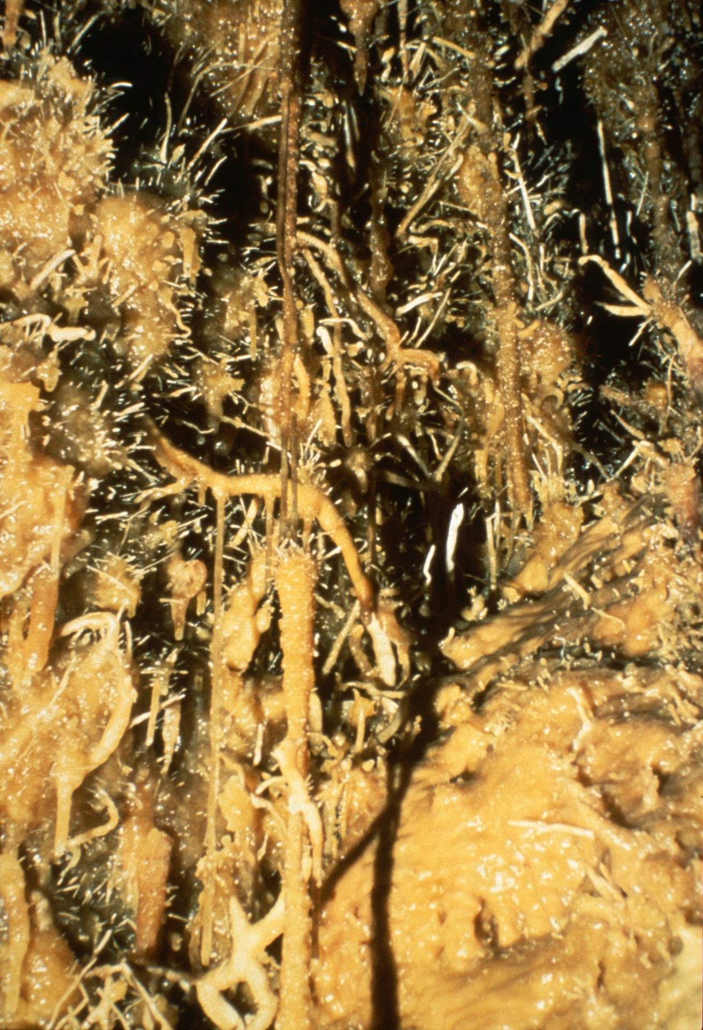
Notes:
A large expanse of butterscotch-colored wall is covered with a bristling “beard” of helictites.

Slide 25
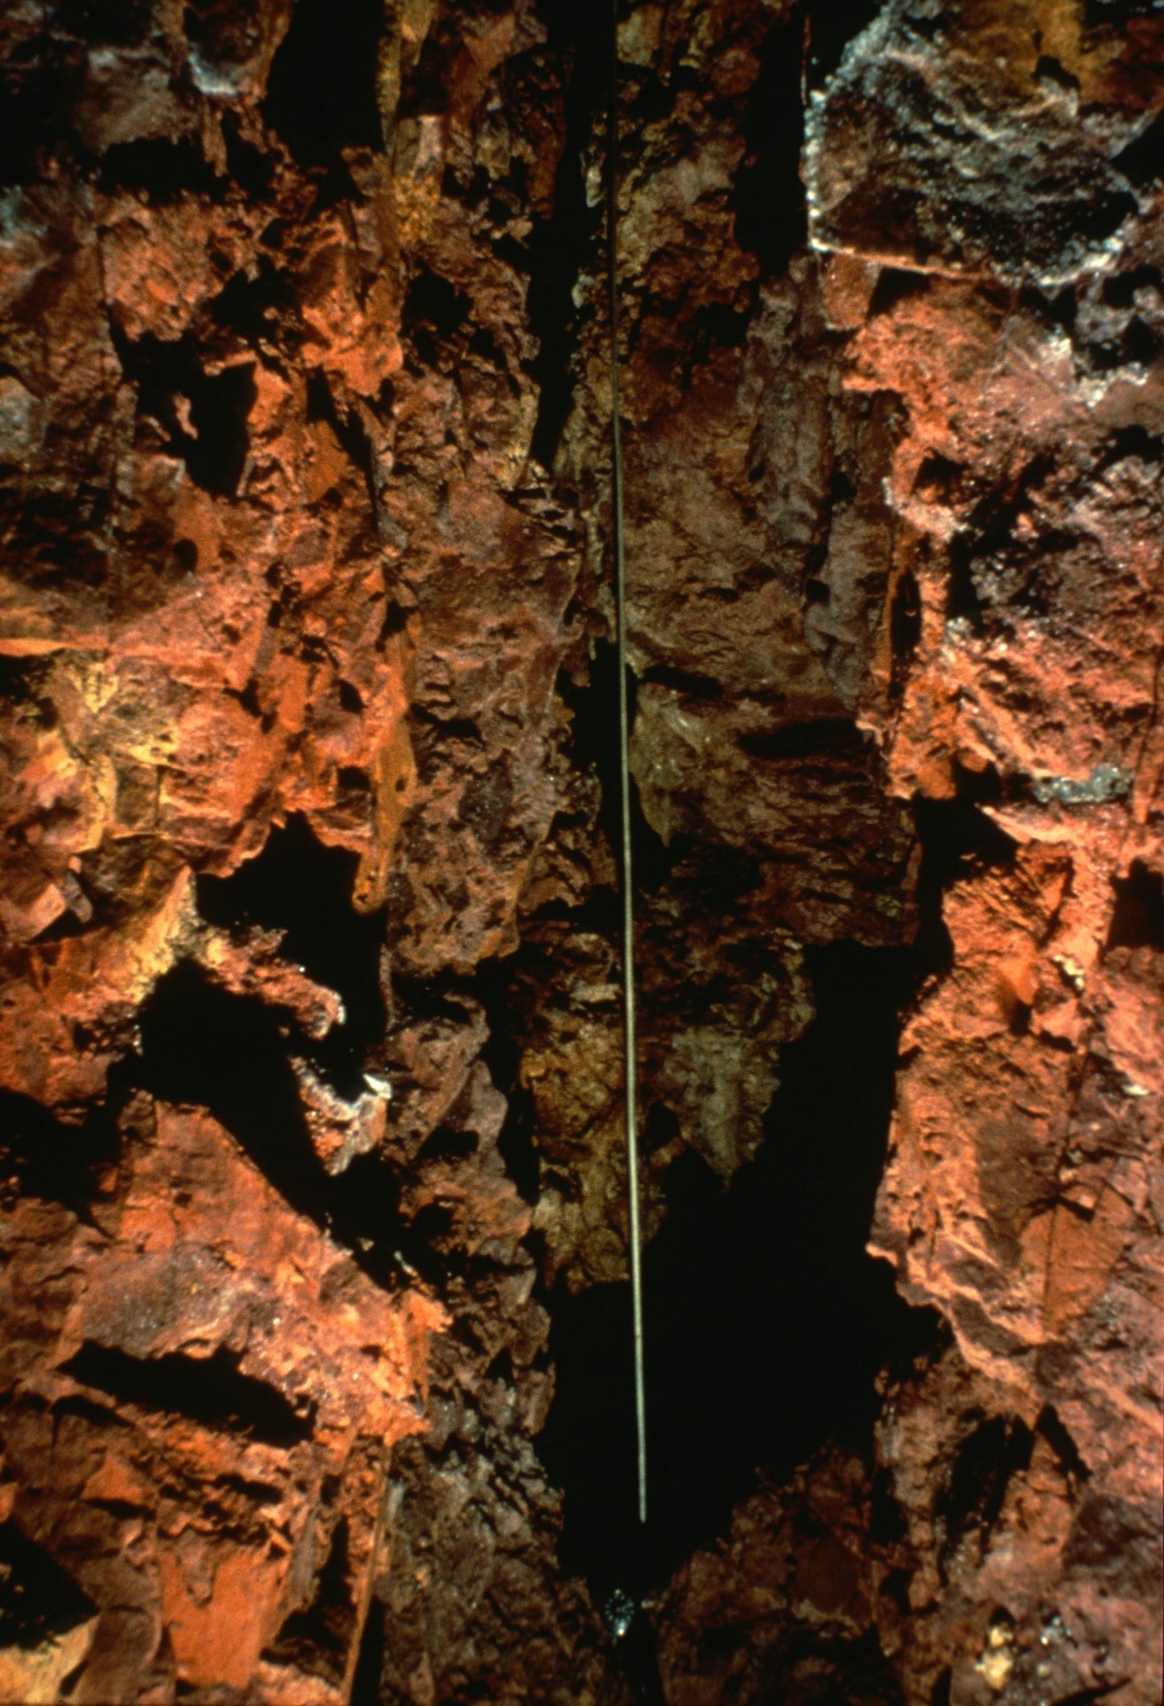
Notes:
The longest known soda straw in the cave is in this room. Note the watch at extreme bottom center for scale. Not quite the entire length of this straw is shown. Astonishingly, the straw ends about a half-inch from the floor, and is about 6 feet long.

Slide 26
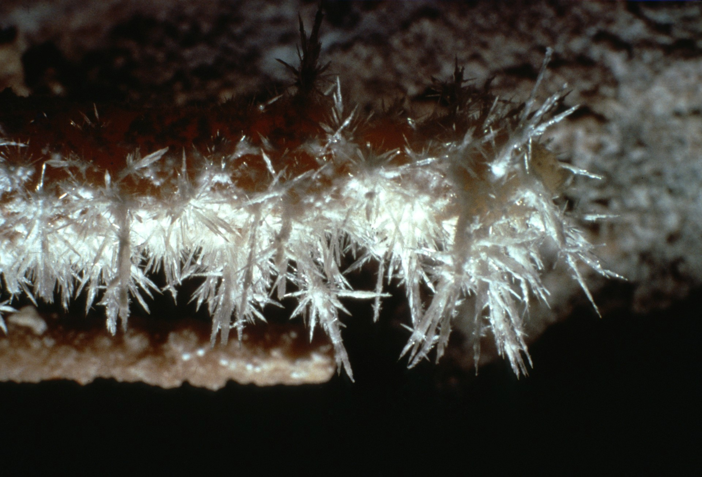
Notes:
A small but outstanding display of acicular aragonite is also a feature of this room. Aragonite is relatively uncommon in Onyx Cave. Only the difficulty of access to this room has preserved these crystals from collectors.

Slide 27
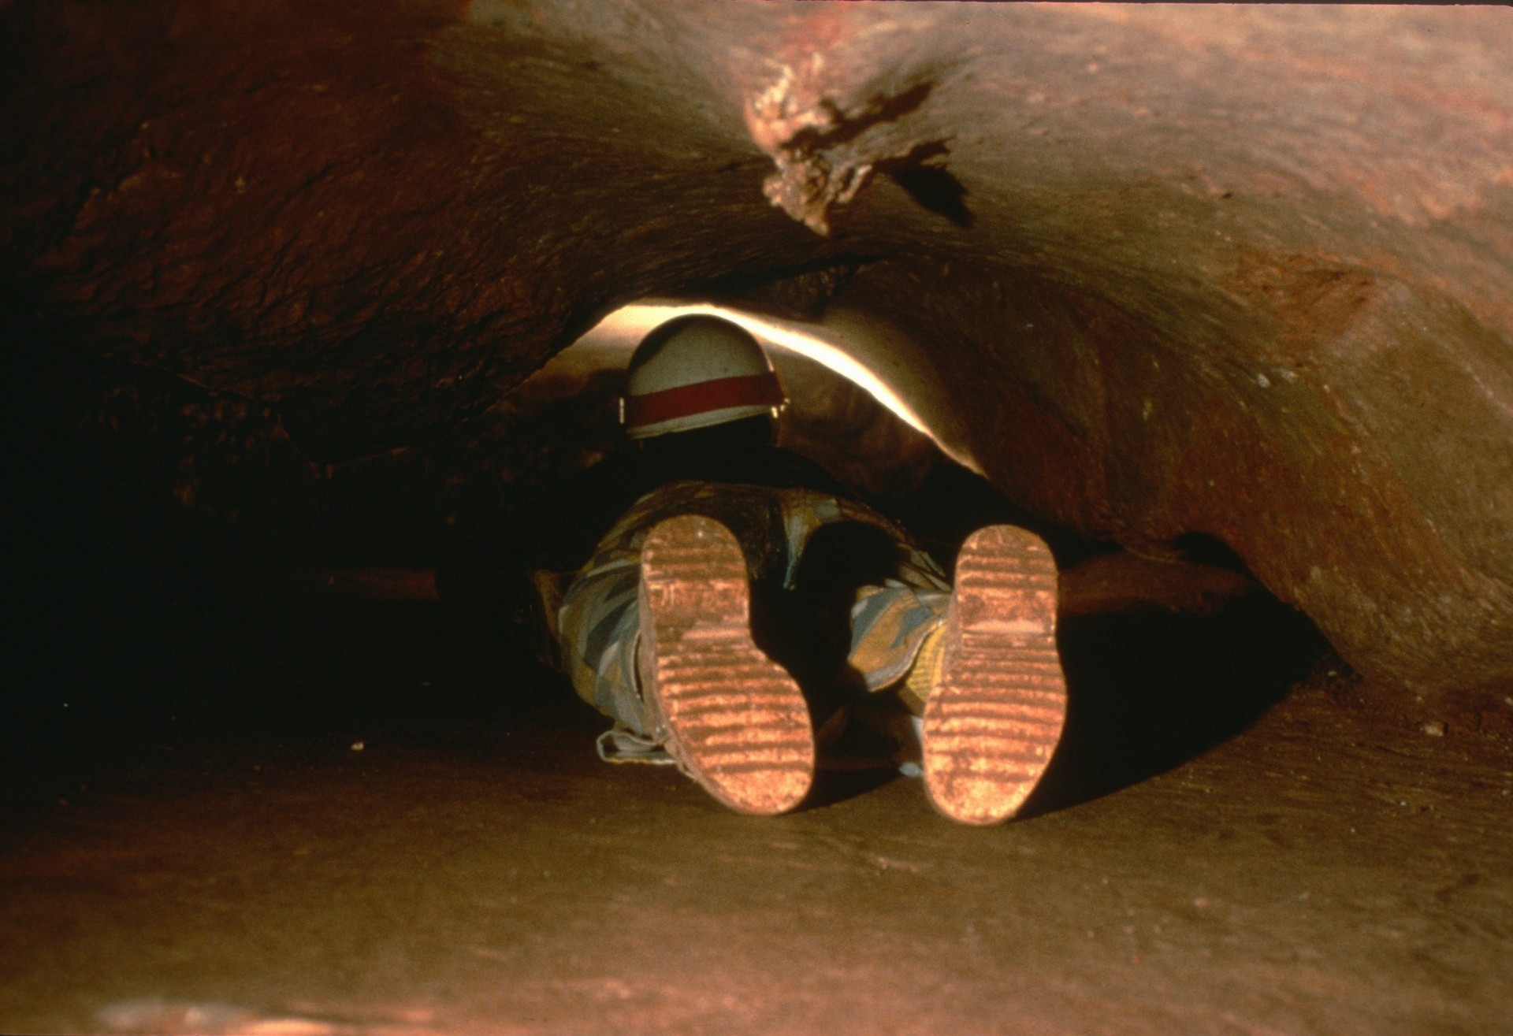
Notes:
As we progress further into the cave, we slither through "The Whale's Mouth." This is a belly-crawl over smooth flowstone about twenty-five feet long.

Slide 28
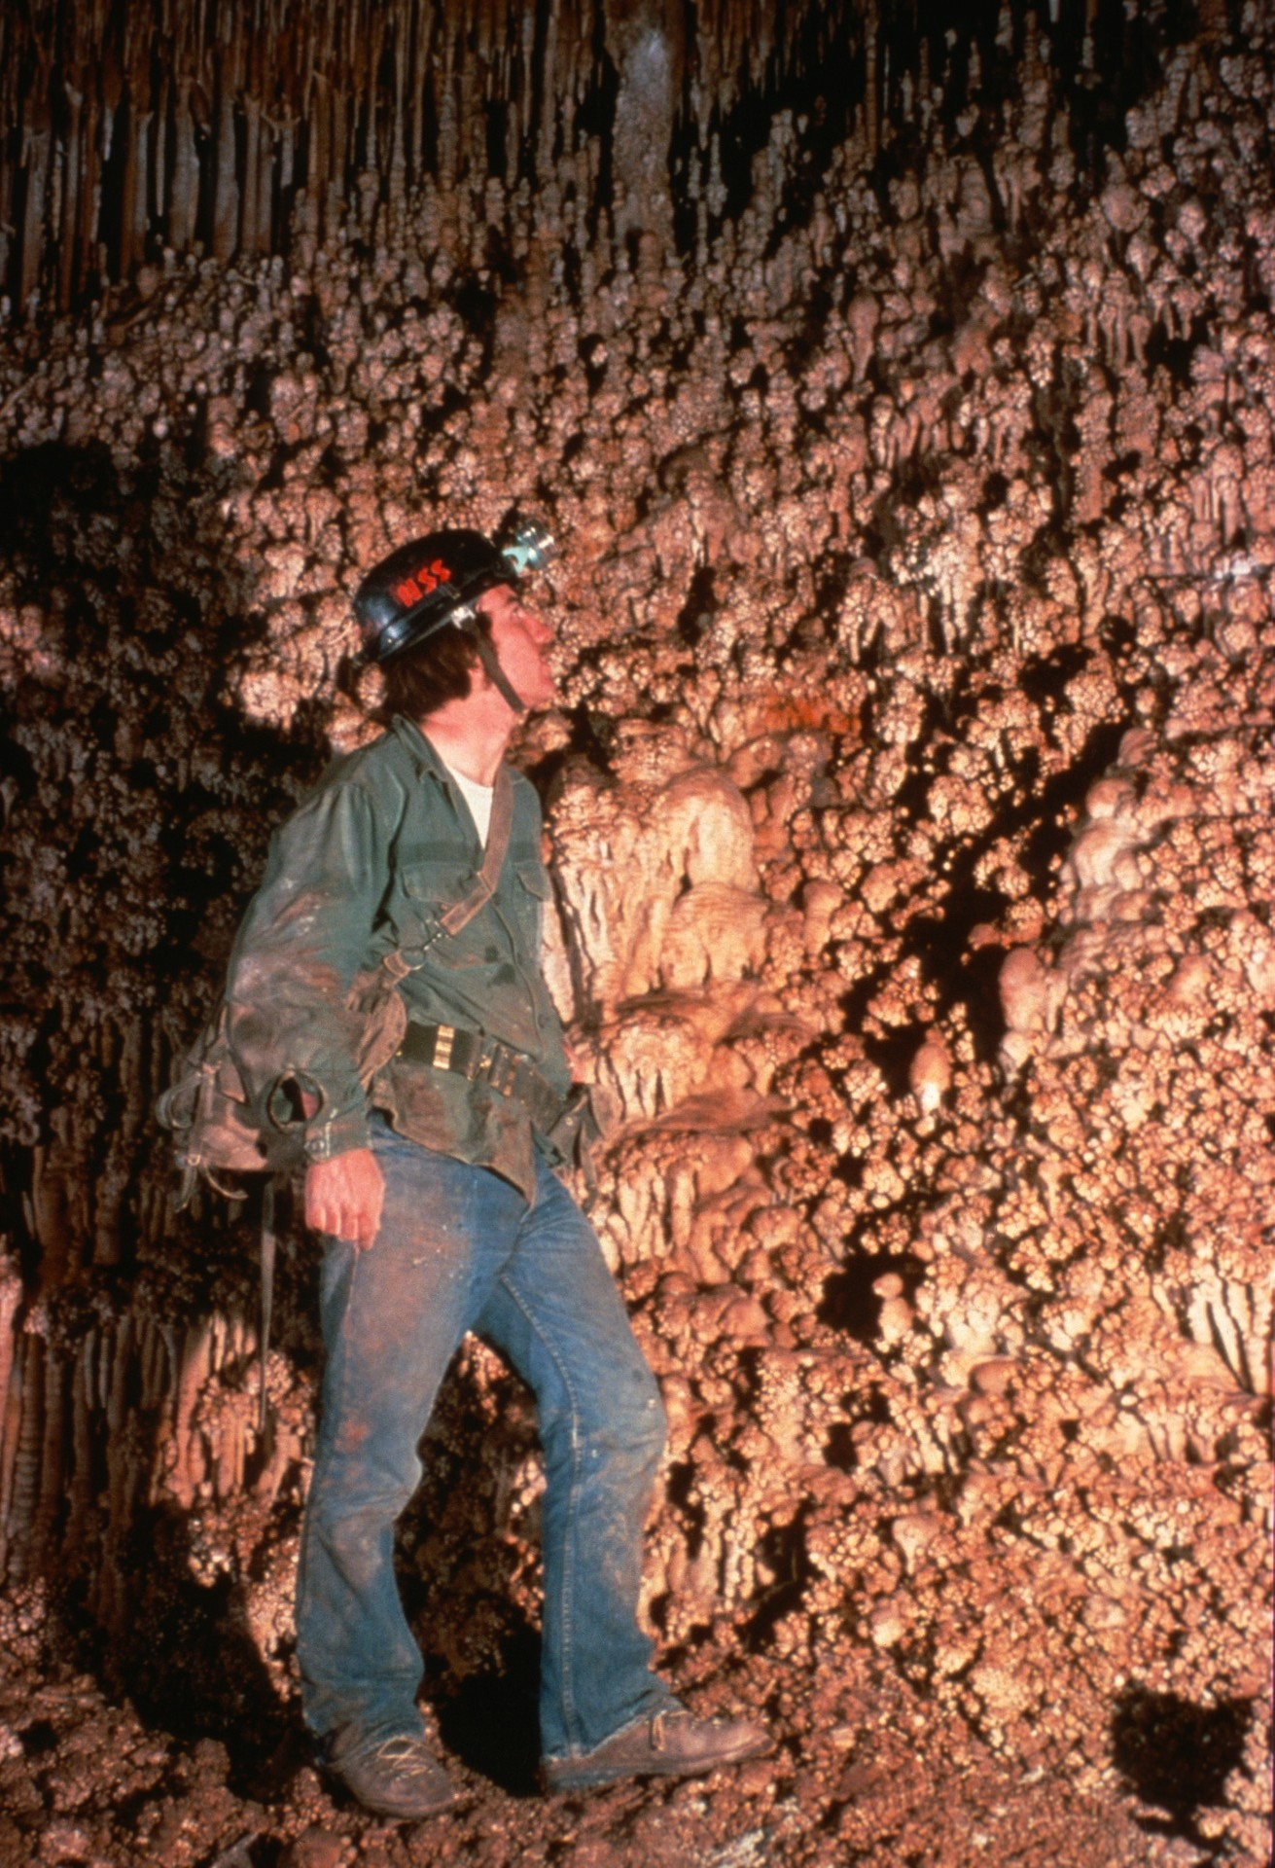
Notes:
Shortly beyond this crawl is the Popcorn Room or The Rock Garden, as it is sometimes called. Roland Browne examines the intricate coral "buds."

Slide 29
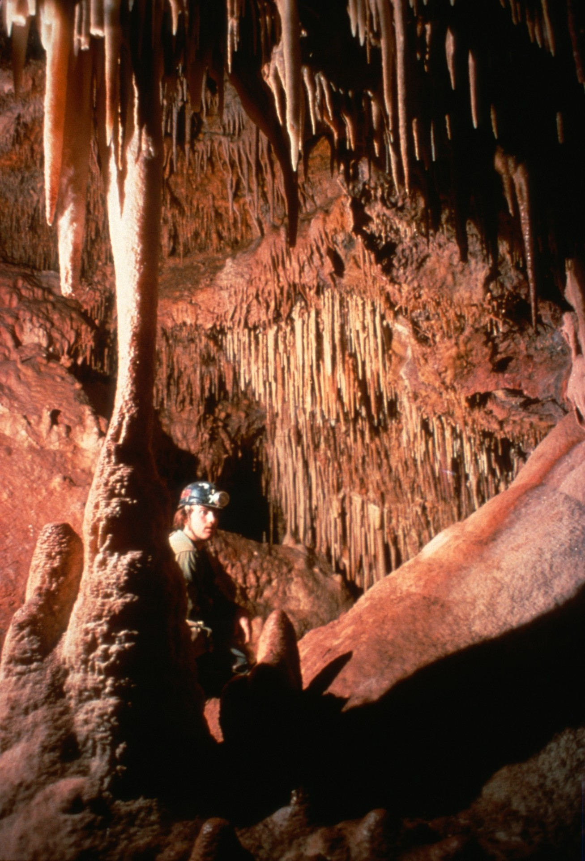
Notes:
A side lead in this area goes to the attractive Three Sisters Room.

Slide 30
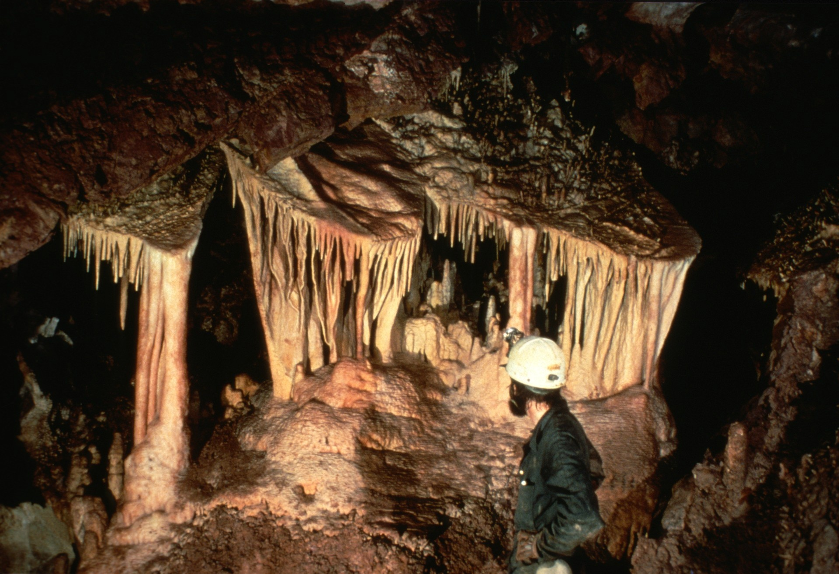
Notes:
The Three Sisters are three textbook-perfect shields in a row. A fourth "sister" is only a few feet away.

Slide 31
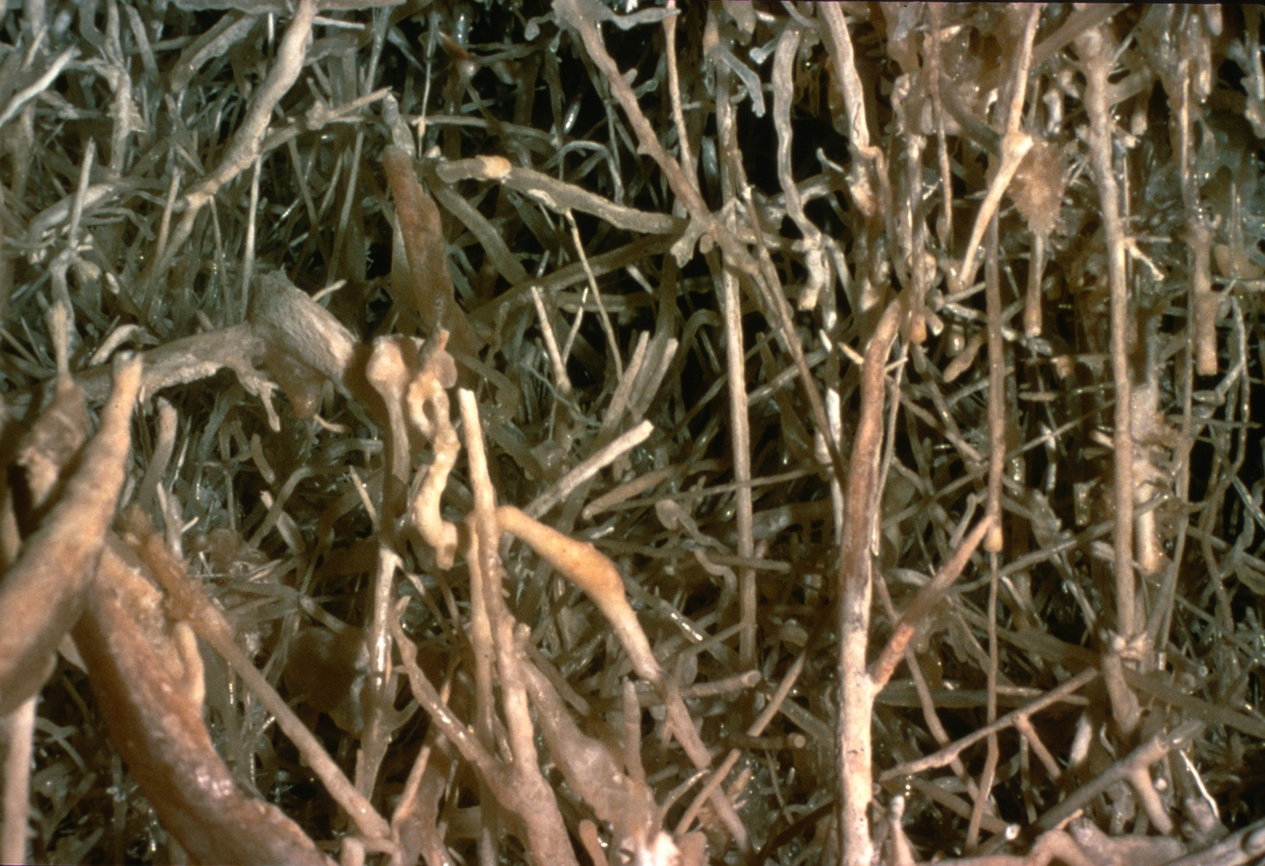
Notes:
The Three Sisters Room also contains the fantastic "Helictite Amphitheater.”

Slide 32
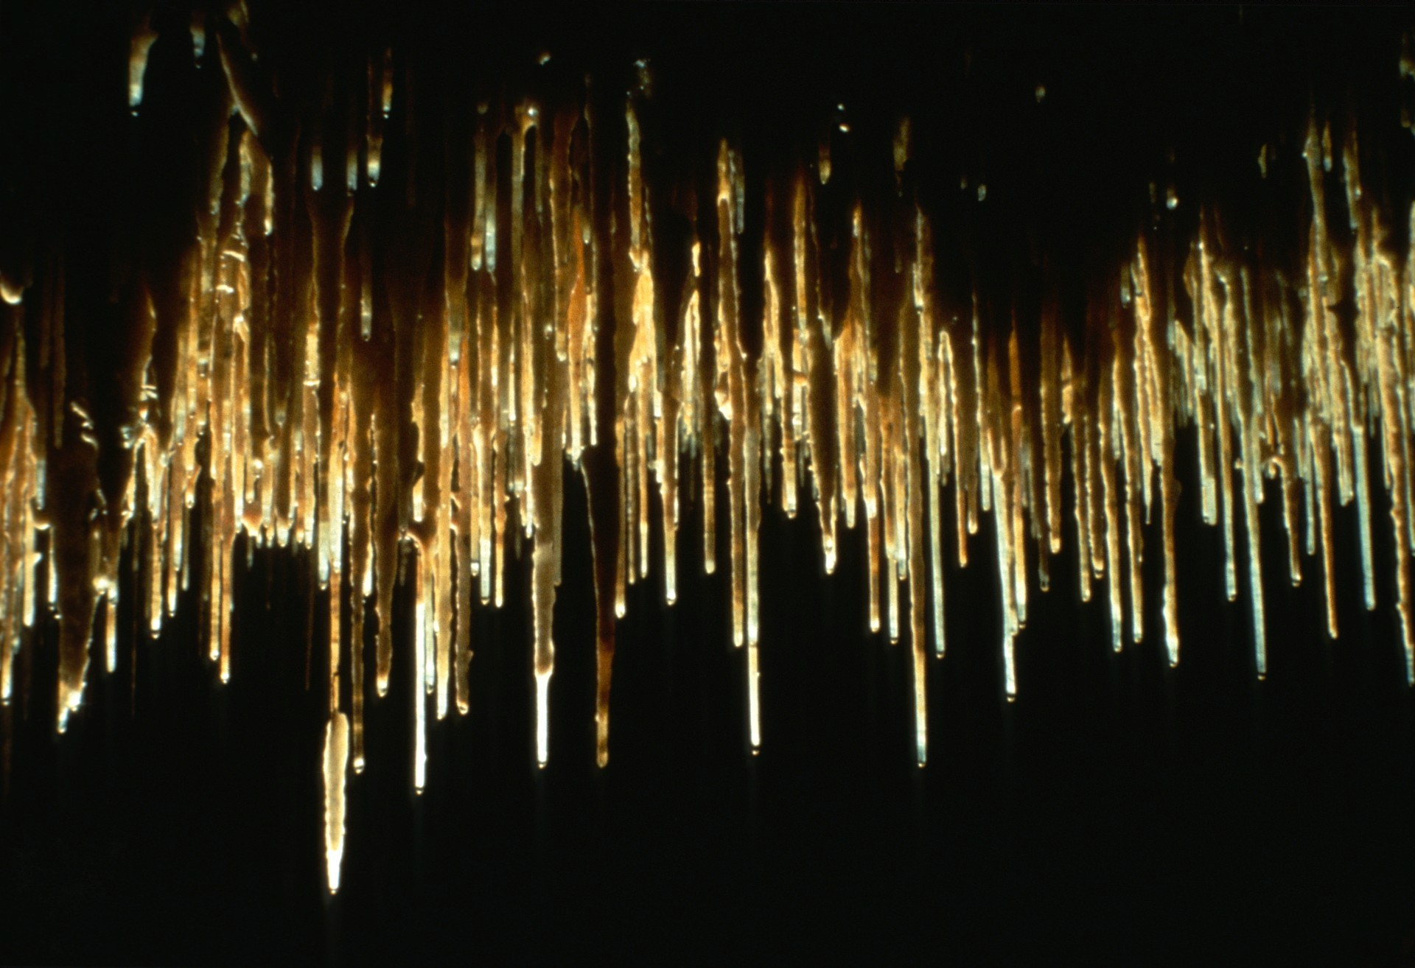
Notes:
A tiny nearby alcove known as "The Attic" is packed with straws.

Slide 33
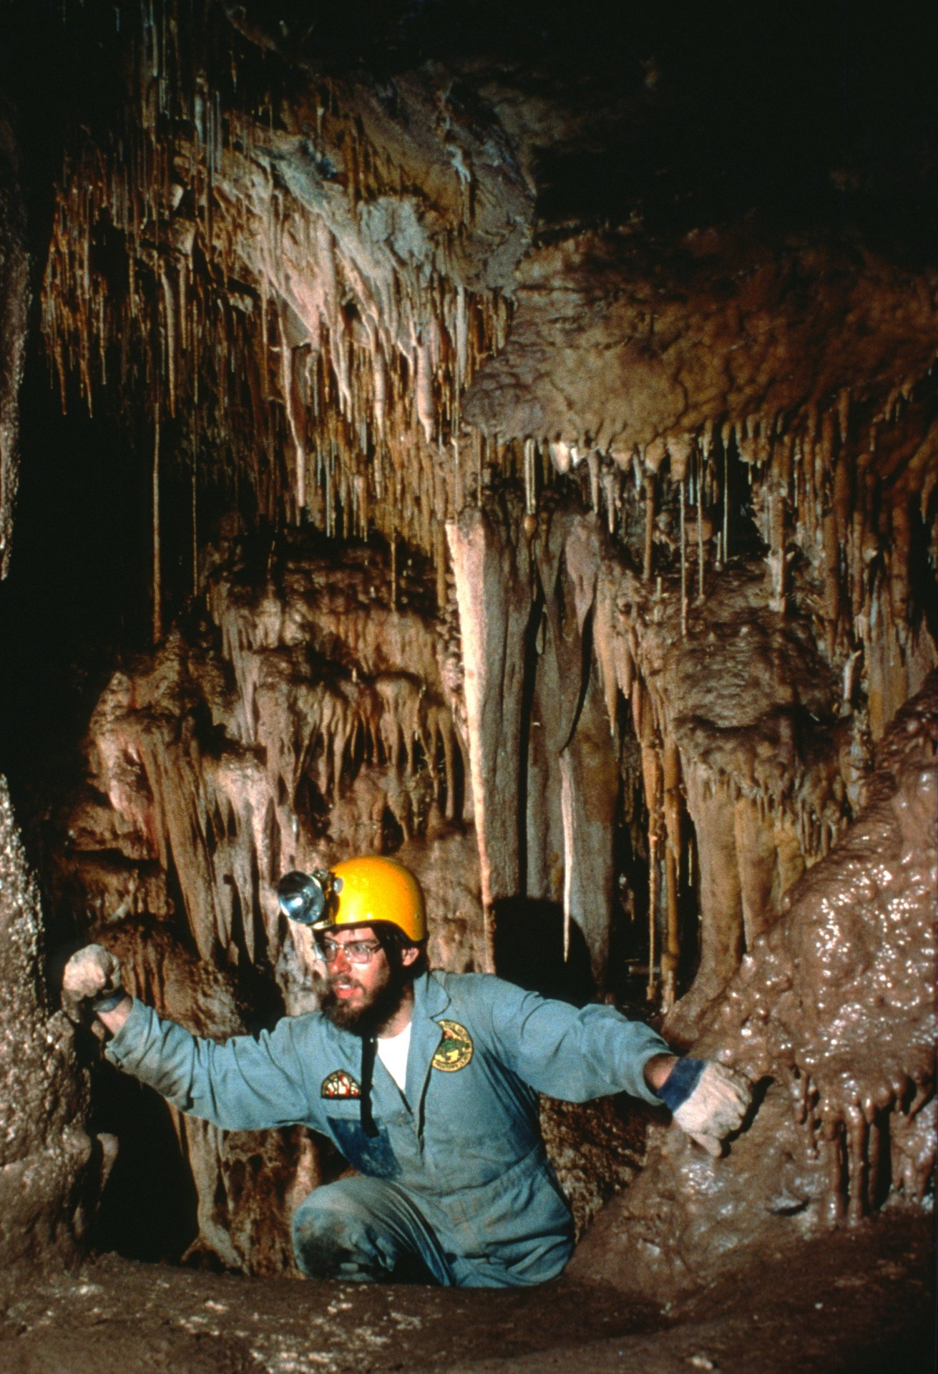
Notes:
Most cavers would regard The Big Room area of Onyx as the most outstanding section of the cave. Two routes, both originating at a room called The Coral Pit, exist. Here Richard LaForge begins the unnerving UAAC (pronounced you-ack) traverse. This route is the quickest and avoids the need for ropes.

Slide 34
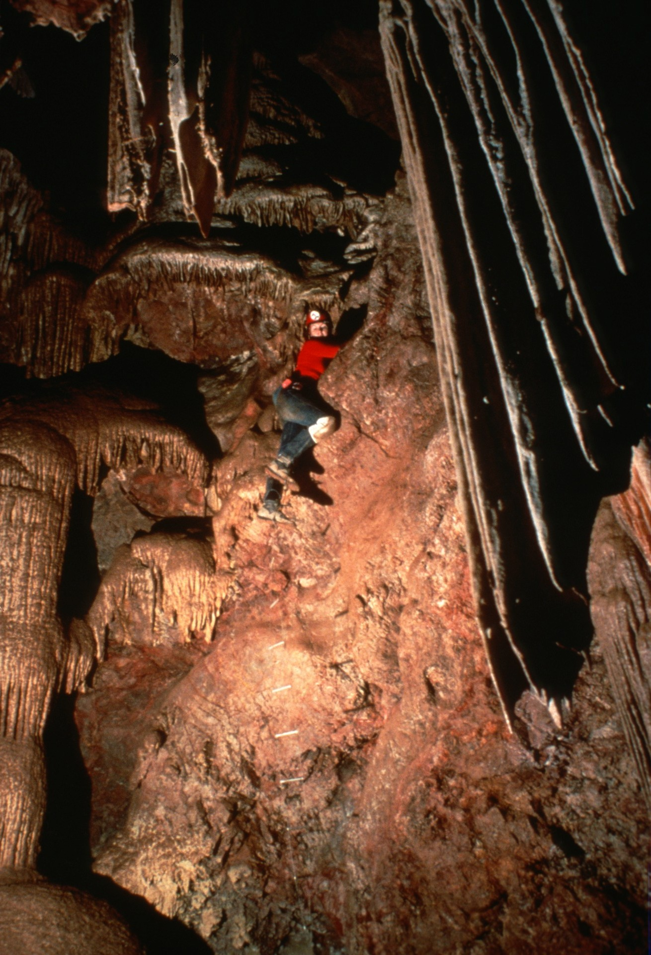
Notes:
More commonly, cavers rig The Coral Pit. Lee Stevens is shown descending here in 1987. The two routes converge shortly in a room called The Window Room. A group of cavers spent several days lost in this room in the late 60s until they were rescued.

Slide 35
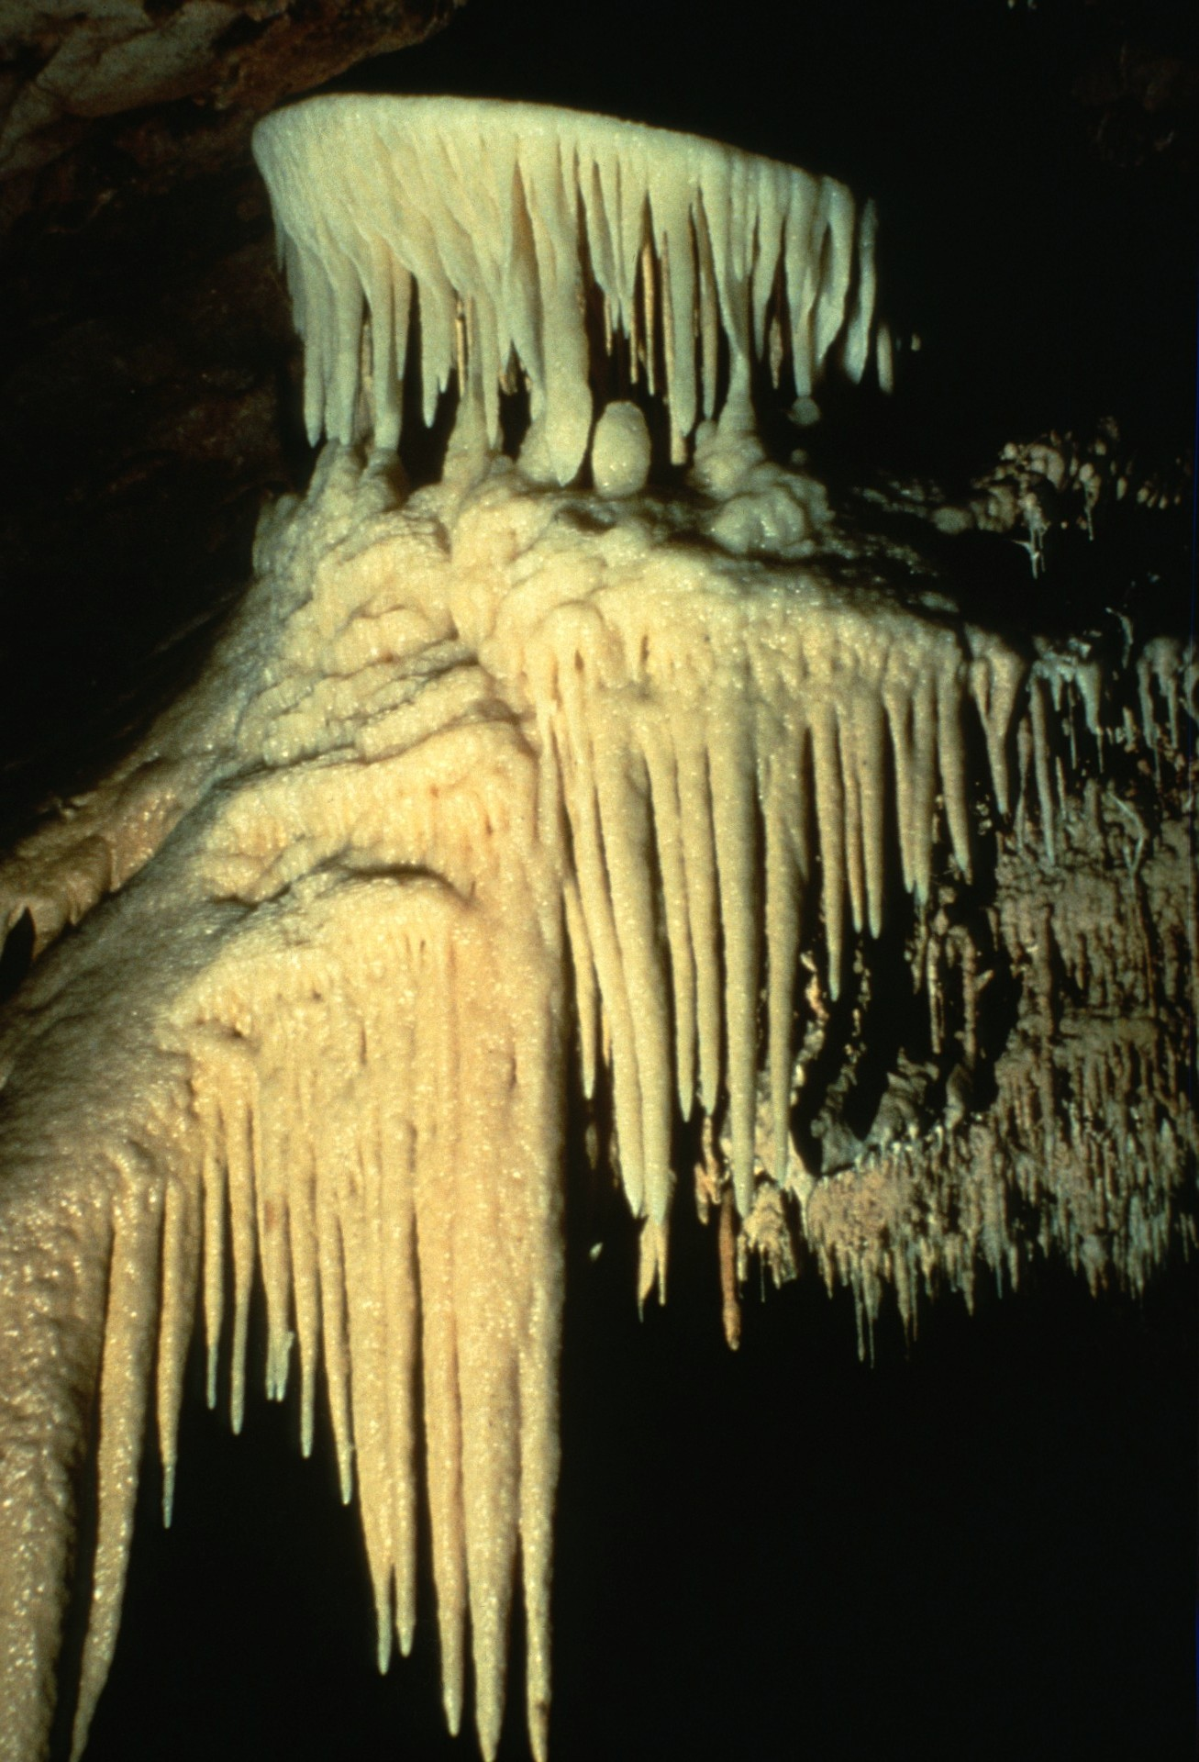
Notes:
This shield is held by most to be the most beautiful shield in Onyx and is a greatly appreciated sight by all those who reach The Window Room. Only its protected location, high above the floor, has saved its delicate draperies from vandalism.

Slide 36
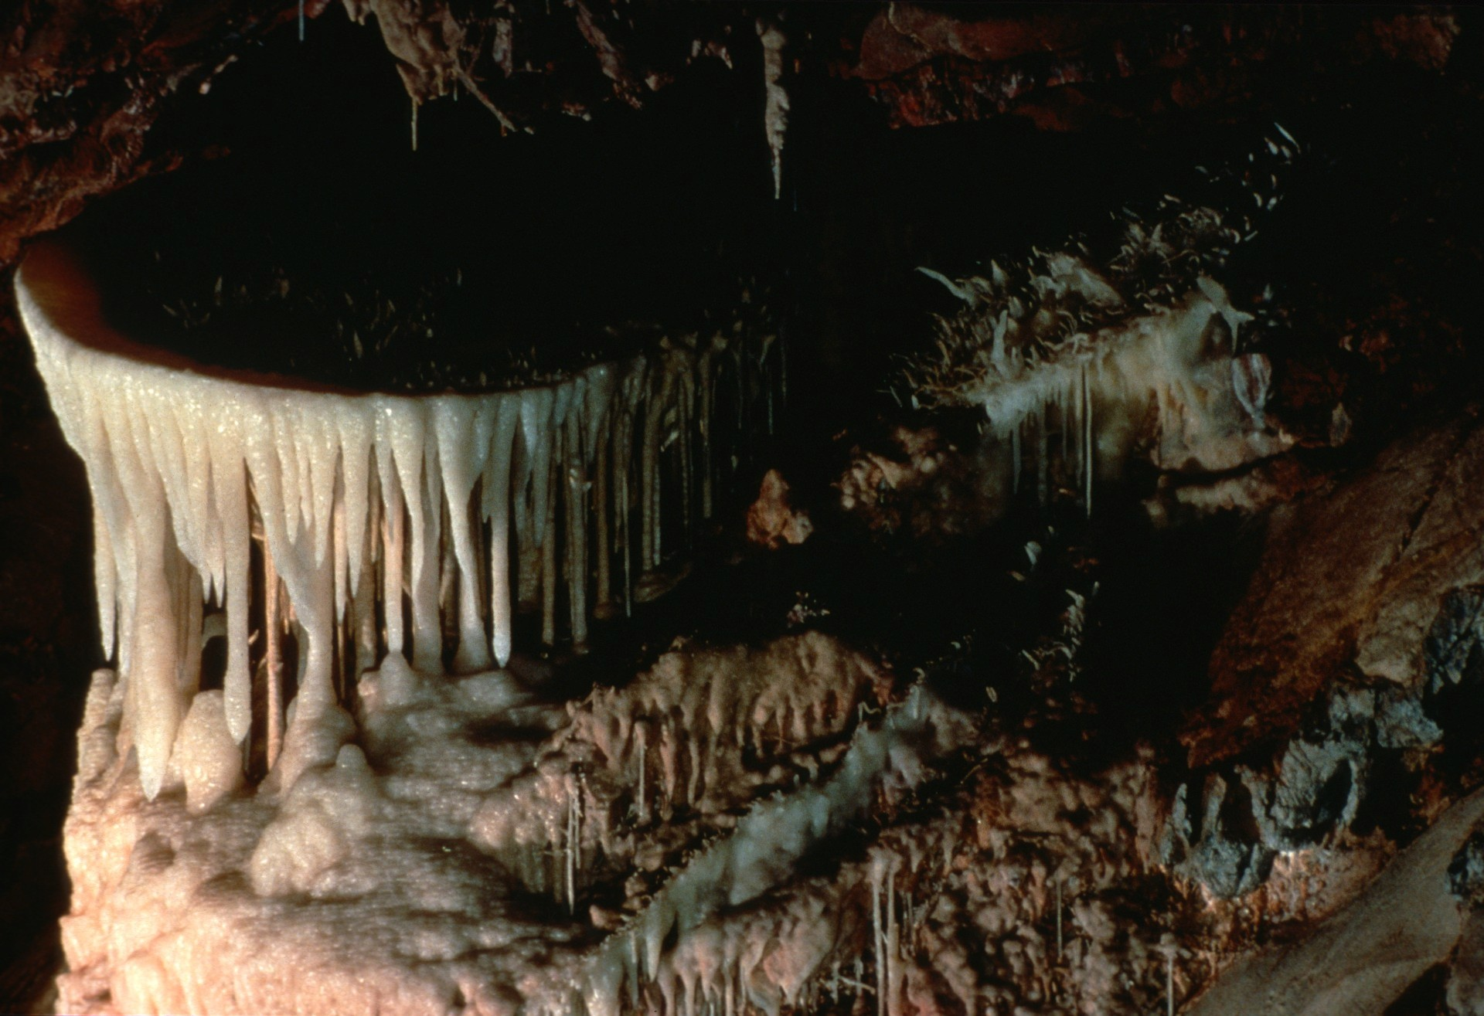
Notes:
Another view of the same shield, taken from a different vantage point with a telephoto lens, shows its classic circular shape and the fine heligmites nearby.

Slide 37
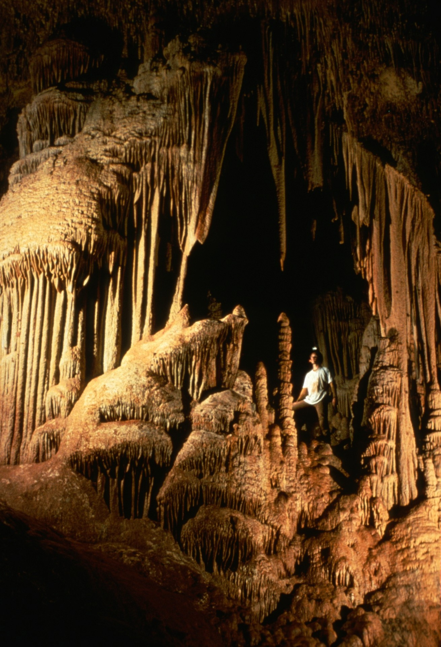
Notes:
Only a few minutes more into the cave is The Big Room. This magnificent archway of stone immediately grabs one's attention.

Slide 38
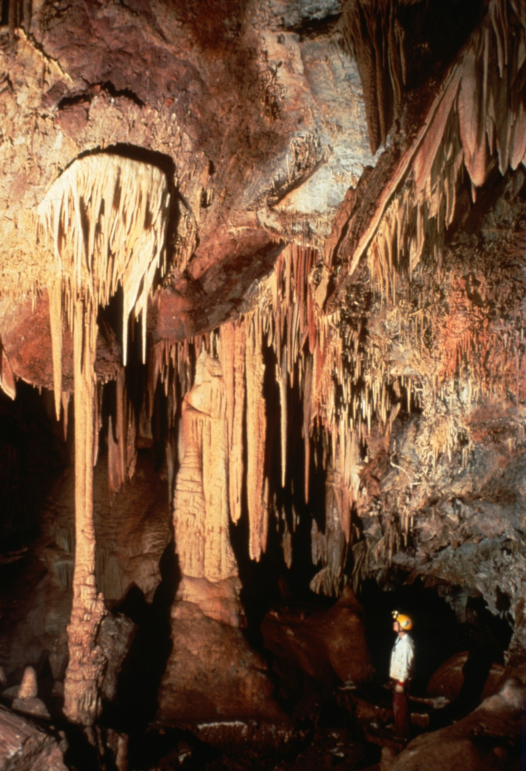
Notes:
Directly opposite the archway is a very large shield resembling a parachute.

Slide 39
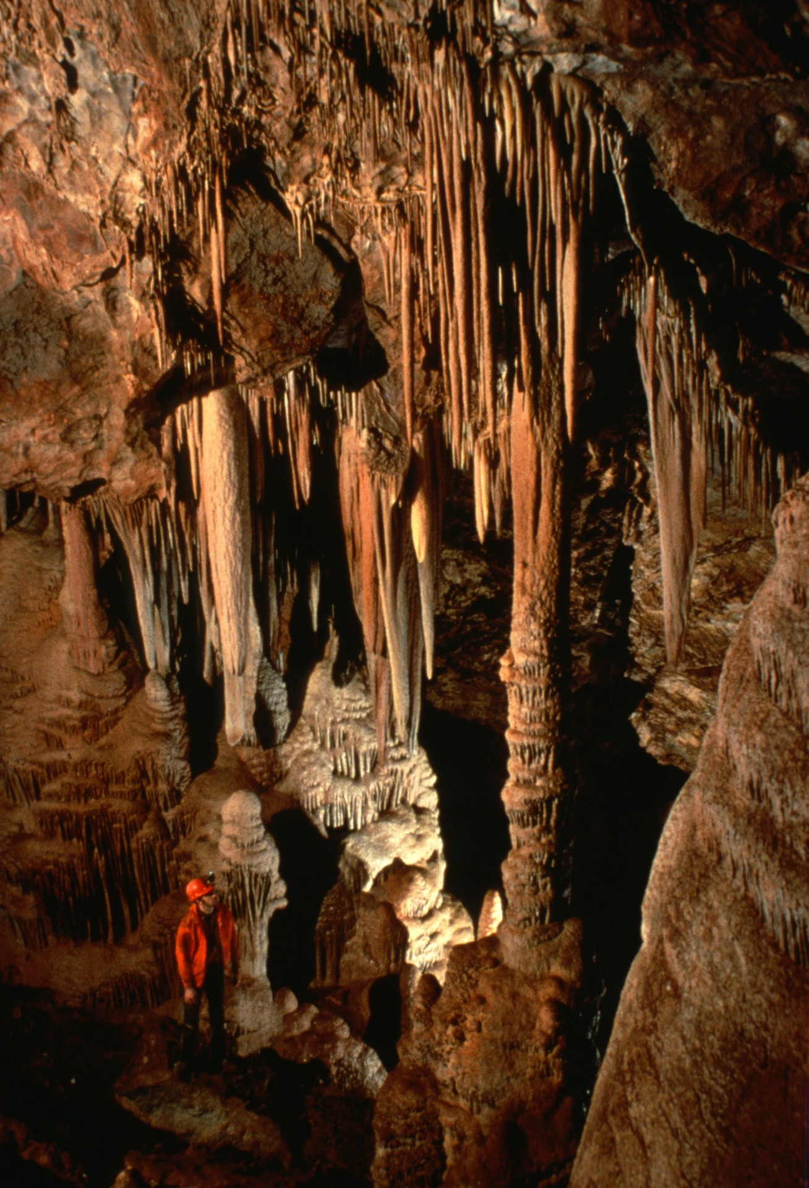
Notes:
This set of draperies, near the end of the Big Room, is one of the most beautiful in the cave. John Scheltens of South Dakota was visiting in 1987 when this shot was taken.

Slide 40
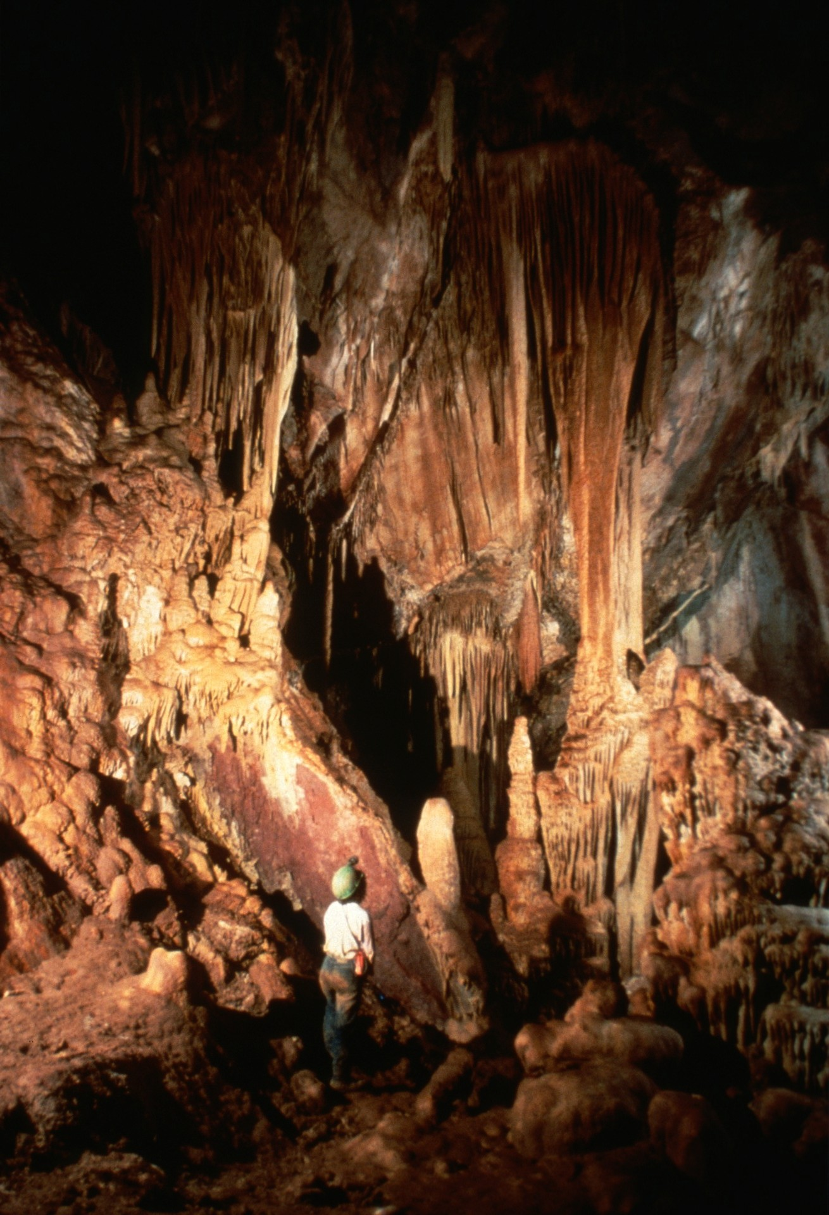
Notes:
Tina Shirk is dwarfed by two great shields growing high above.

Slide 41
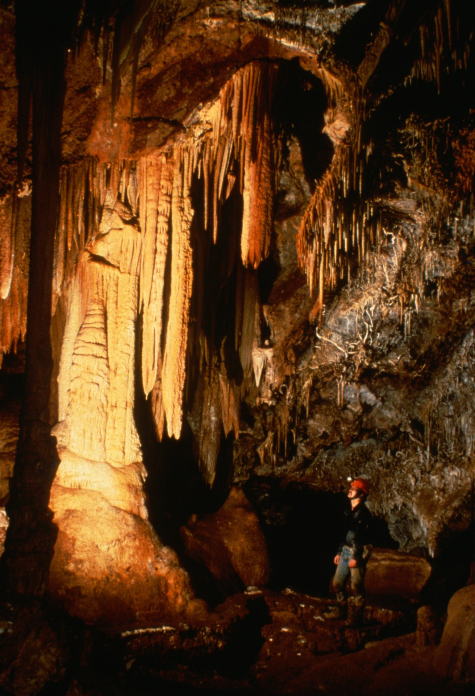
Notes:
On the opposite wall of the Big Room, an interesting side lead begins directly behind the caver.

Slide 42
Sorry - Image missing
Notes:
Scott Gibson admires the profuse decorations in this lead.

Slide 43
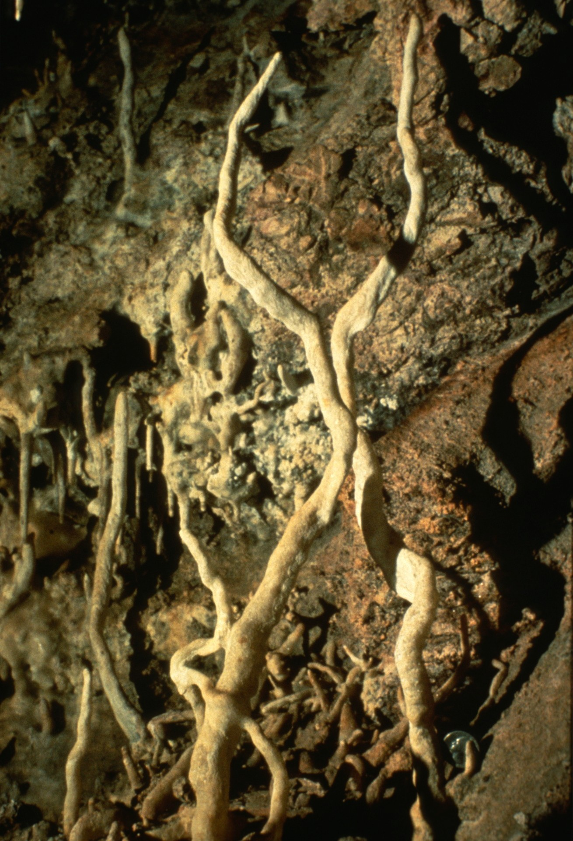
Notes:
Two of the longest heligmites in Onyx Cave, or in Arizona for that matter, twine upward in this lead. Note the quarter at lower right for scale. Note also how a third 'mite penetrates through the left large heligmite near its bottom!

Slide 44
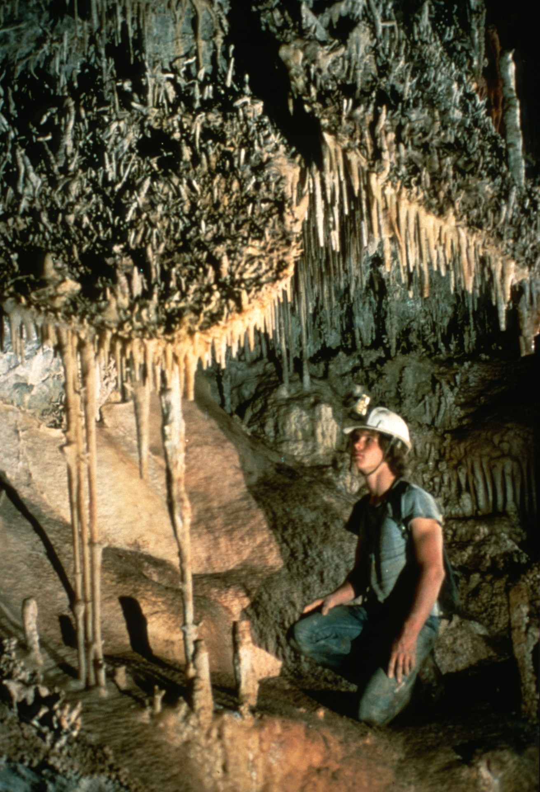
Notes:
Returning to the Big Room, here are the famous Twin Shields, a landmark of the room.

Slide 45
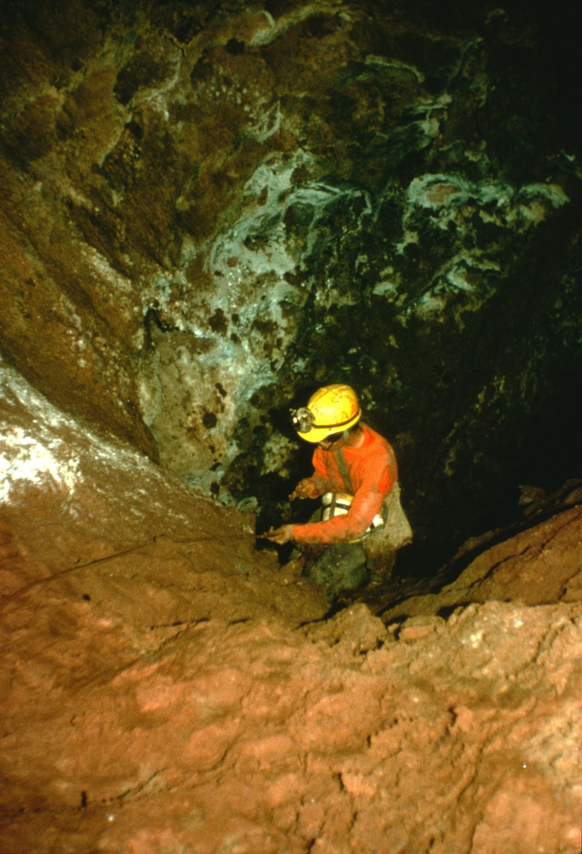
Notes:
At the lowest point of the Big Room, a very slimy lead goes to the Mud Chutes. At the bottom is the lowest point in the cave.

Slide 46
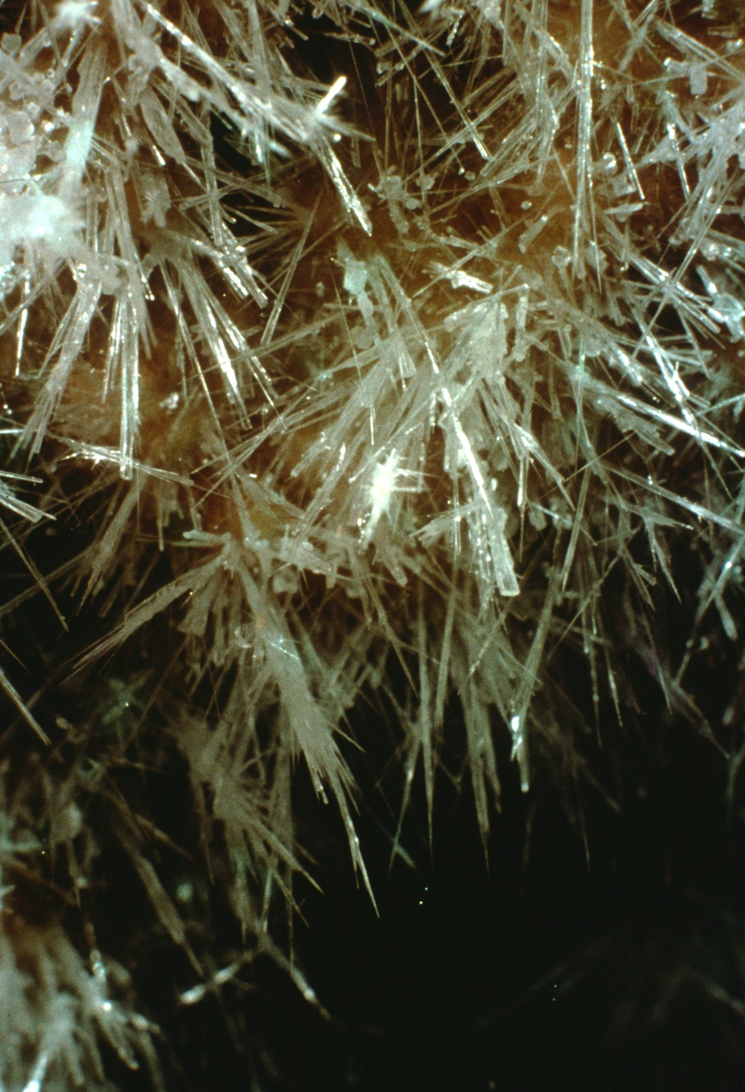
Notes:
While few large formations occur here, some of the most delicate crystals anywhere in Onyx grow here.

Slide 47
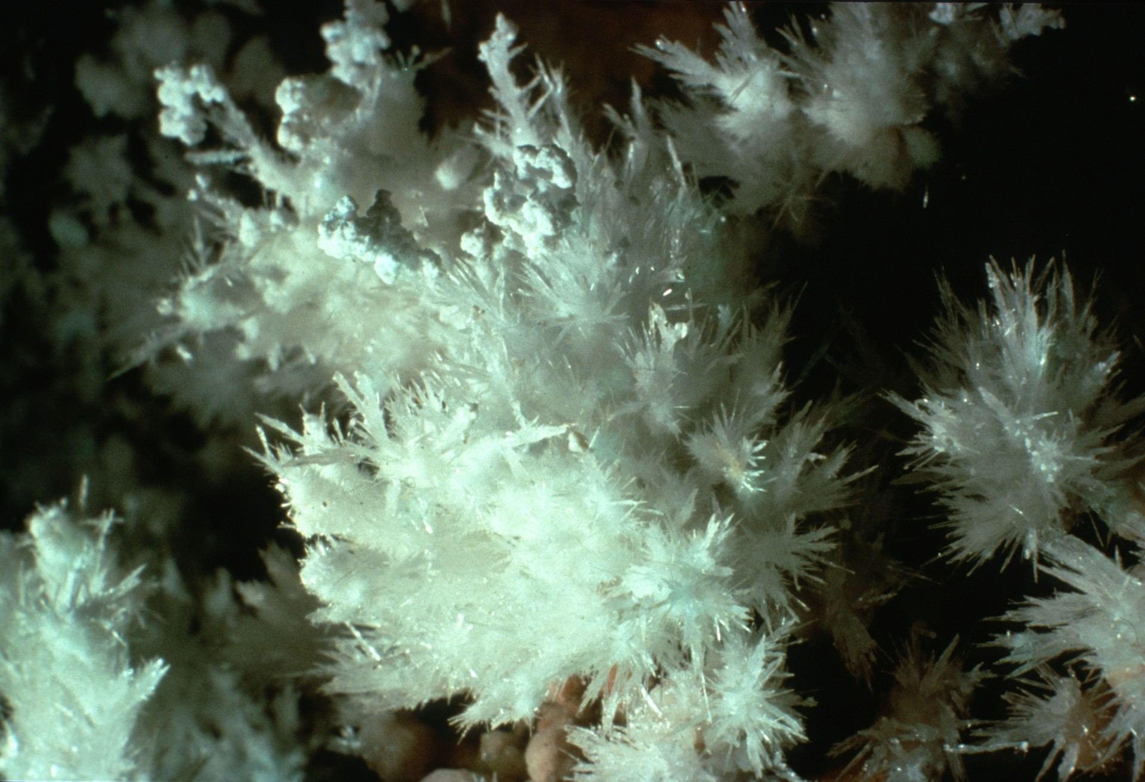
Notes:
Moonmilk, very rare and unspectacular elsewhere in Onyx, tips these aragonite crystals in the Mud Chutes area.

Slide 48
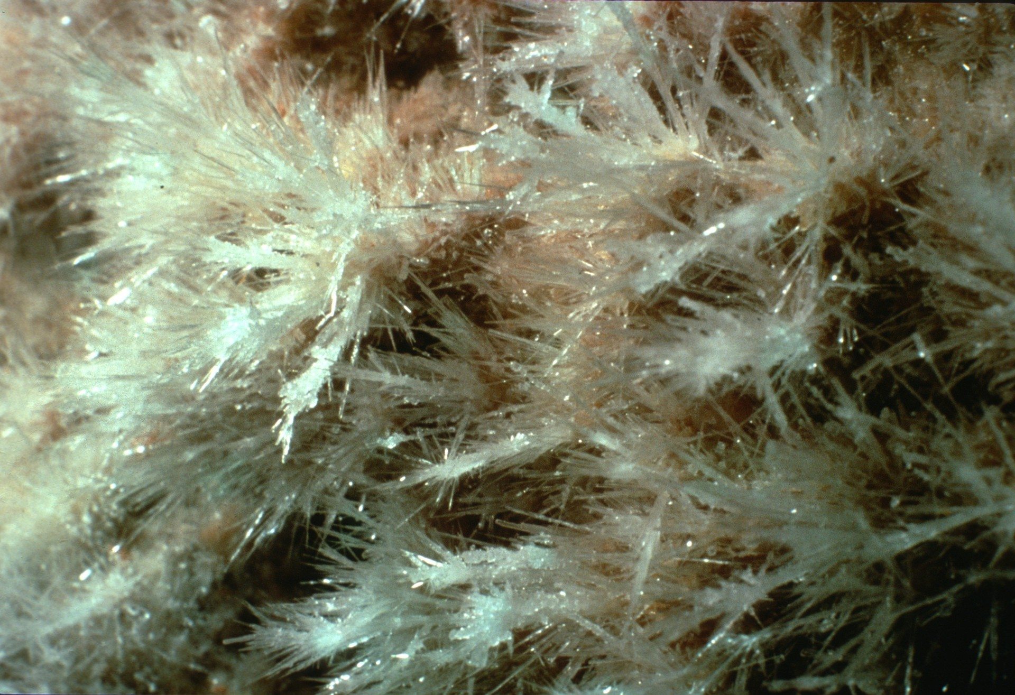
Notes:
Another view of aragonite in the Mud Chutes.

Slide 49
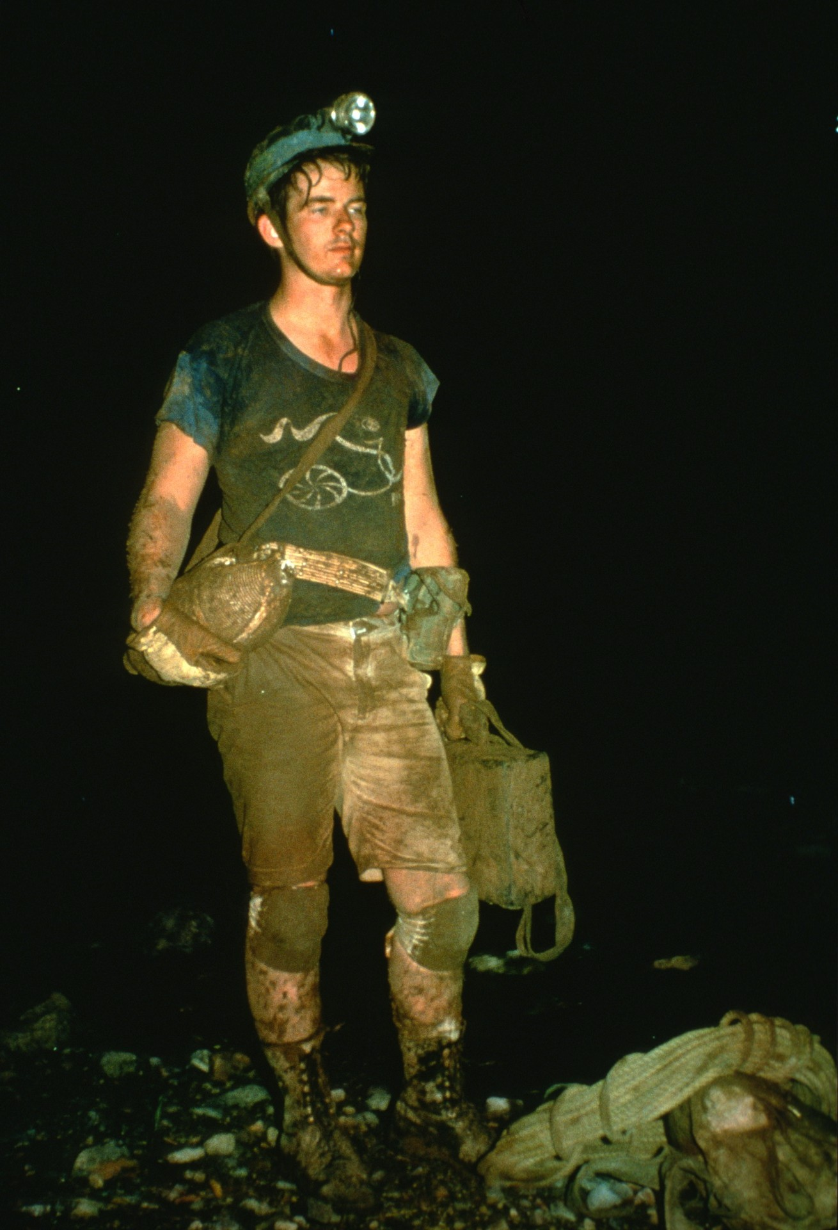
Notes:
A tired Rick Day reflects after a trip to the Mud Chutes in 1974.

Slide 50
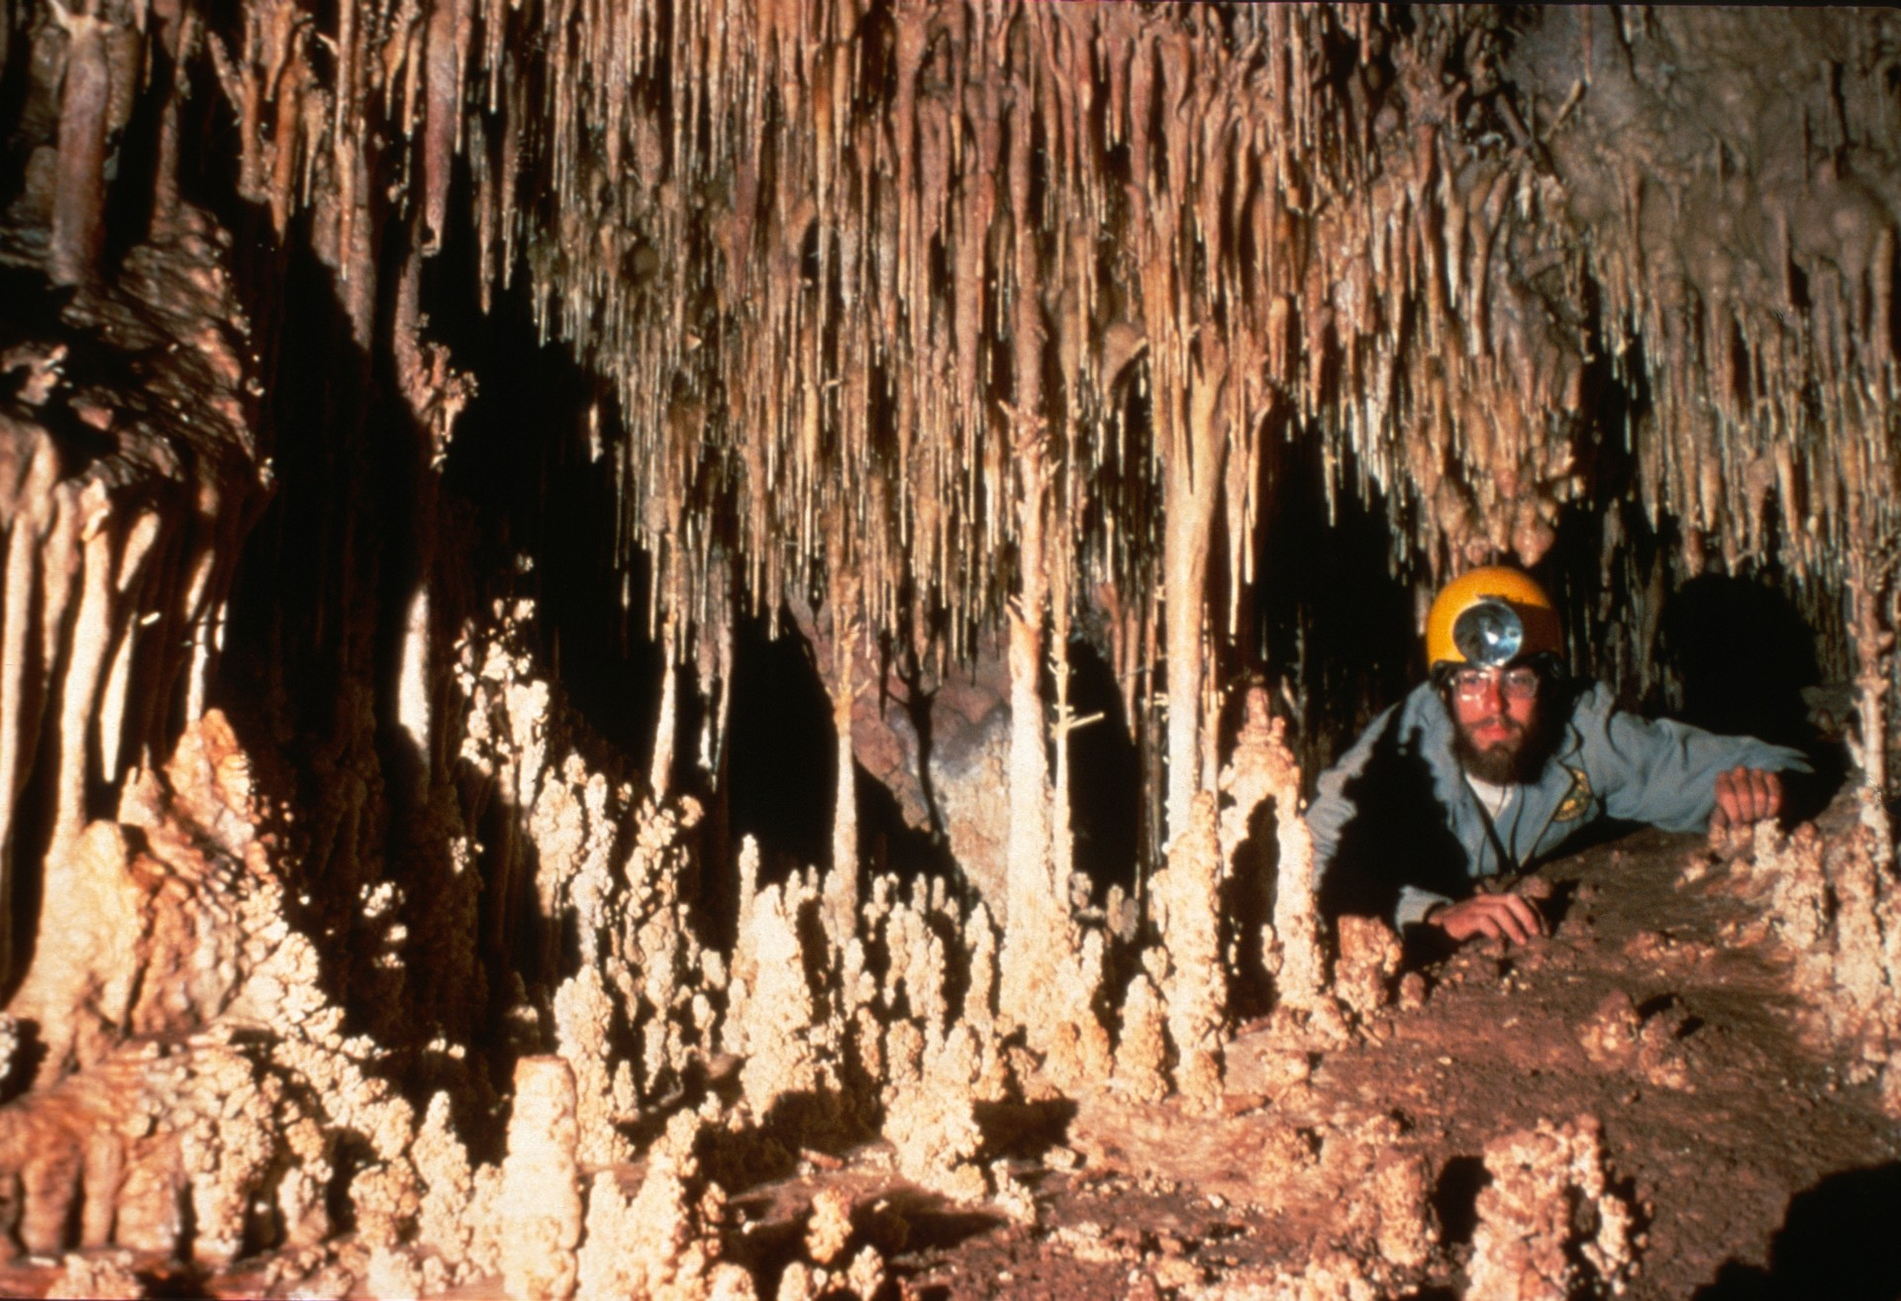
Notes:
While the Big Boom is most noted for its large formations, crawlways lead off it to small rooms filled with wonders.

Slide 51
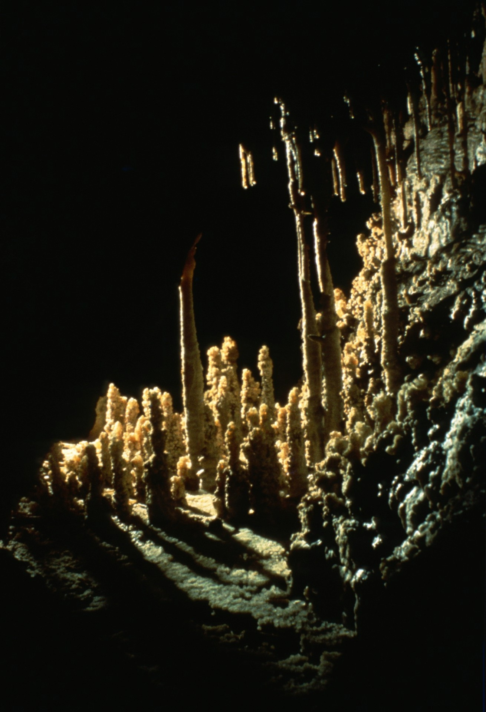
Notes:
This grouping of stalagmites suggests one of the prehistoric Indian ruins the Southwest is famous for.

Slide 52
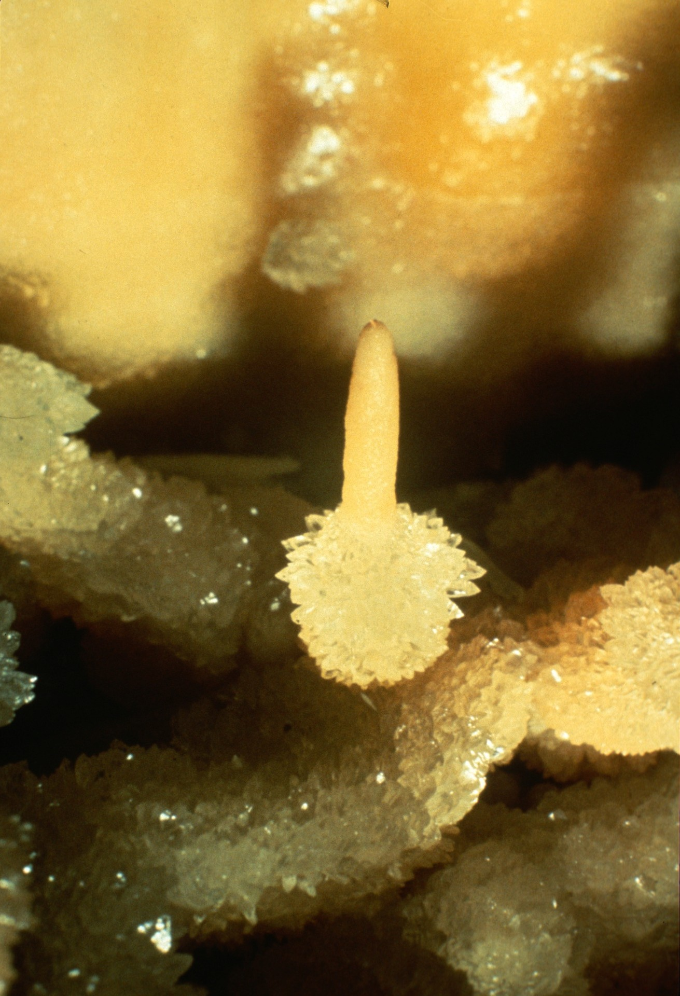
Notes:
This tiny stalagmite, only an inch high, looks like a birthday candle.

Slide 53
Notes:
Pockets in the floor generally are filled with calcite crystals. This area was lucky enough to escape the attention of collectors.

Slide 54
Notes:
Another area of the same pocket was worked over by some clod with a chisel. The three blows in the center of the picture undoubtedly did nothing but powder the crystals.

Slide 55
Notes:
This apricot-colored flow contains a dry pool decorated with starbursts of calcite.

Slide 56
Notes:
We exit past this vast "temple" and proceed to the neighboring Root Room area. The Root Room is really an extension of the Big Room.

Slide 57
Notes:
Much of the flavor of the Big Room is retained in the Root Room area. This is one of the best preserved shields in Onyx.

Slide 58
Notes:
Right next to the shield is one of the largest stalagmites in the cave

Slide 59
Notes:
A great gallery leads down to an area where roots penetrate the roof of the cave. These magnificent drapes begin it.

Slide 60
Notes:
Nelson Day looks down the beautifully draped corridor leading to the root area.

Slide 61
Notes:
Near the end of the drapes it is possible to get behind them and peek out through this window.

Slide 62
Notes:
The area behind the curtains contains more than its share of delicacies. Here are some microhelictites in colorful contrast.

Slide 63
Notes:
These little jewels are not far away.

Slide 64
Notes:
Leaving the Root Room area, we return to the main route through the cave, known as The Loop. Bill Stone looks at this apricot-colored shield in a photo taken in 1975. The ready accessibility of the formation has led to damage by vandals on its draperies.

Slide 65
Notes:
The largest room on The Loop is known as The Cathedral Room. This room has been extensively restored by members of the Arizona Regional Association and the Southwest Region.

Slide 66
Notes:
You have now completed your tour through the most interesting and least spoiled areas of Onyx Cave, Arizona. The following 11 slides are offered as a sort of summary and an attempt to capture the spirit of the cave in a nutshell. Here is "The Carrot Patch."

Slide 67
Notes:
Onyx Cave is a realm of subtle colors.

Slide 68
Notes:
Formations often show two growth periods, as when calcite crystals coat stubby stalactites.

Slide 69
Notes:
Helictites, too, can be improved upon by crystal coating.

Slide 70
Notes:
Majestic shields tower overhead.

Slide 71
Notes:
Beneath the shields lie calcite root gardens.

Slide 72
Notes:
The cave rewards the eye with beauty in great grandeur…

Slide 73
Notes:
…down to the smallest detail.

Slide 74
Notes:
Crystal bars guard secret chambers…

Slide 75
Notes:
…where the work of The Creator continues, drop by drop…

Slide 76
Notes:
…to build perfection in stone.

Slide 77
Notes:
THE END. Mt. Wrightson at sunset.
POSTSCRIPT: Onyx Cave is leased by Escabrosa Grotto, Inc. of Tucson. If you would like to visit Onyx Cave, please write at least two weeks in advance for permits. Obtain Escabrosa's mailing address from the current NSS Members Manual. Visits by experienced cavers are welcomed, but Onyx Cave is not suitable for first-time cavers, due to the numerous exposed climbs.

Slide 78
An NSS Audio-Visual Library Presentation
Onyx Cave, AZ
Escabrosa Grotto of the NSS
Original slide program S740
Slides digitized by David Caudle
Script transcribed by Alex Sproul
PowerPoint program created by Jim McConkey
78 slides, with script in presenter notes
PowerPoint created 2/09/2021
National Speleological Society
6001 Pulaski Pike
Huntsville, AL 35810-1122
256- 852-1300
nss@caves.org
https://caves.org/

